Slide 1

‘Naya Raipur’
A smart city in making
Dilip Shekdar
Architect and Planner
Naya Raipur Development Authority

Slide 2
Agenda
Chhattisgarh
Naya Raipur
  Planning
  Infrastructure
  Smart City planning
  ITS for BRTS
  Snap shots
Snaps of Naya Raipur

Slide 3
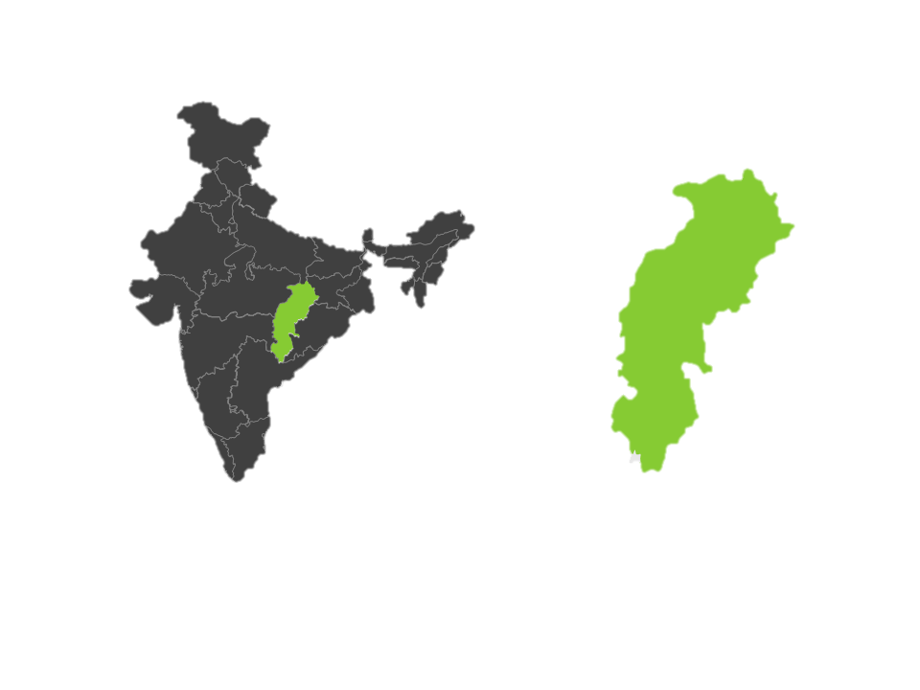
Chhattisgarh Snapshot
25 million people
Capital area agglomeration of 2 million plus
Growing rapidly

Slide 4
Mineral Rich
Annual mineral produce worth $ 2.7 billion −
one-eight of India’s
Topmost coal producer
Third in iron ore
Only tin ore producer
Major limestone, dolomite and bauxite producer

Slide 5
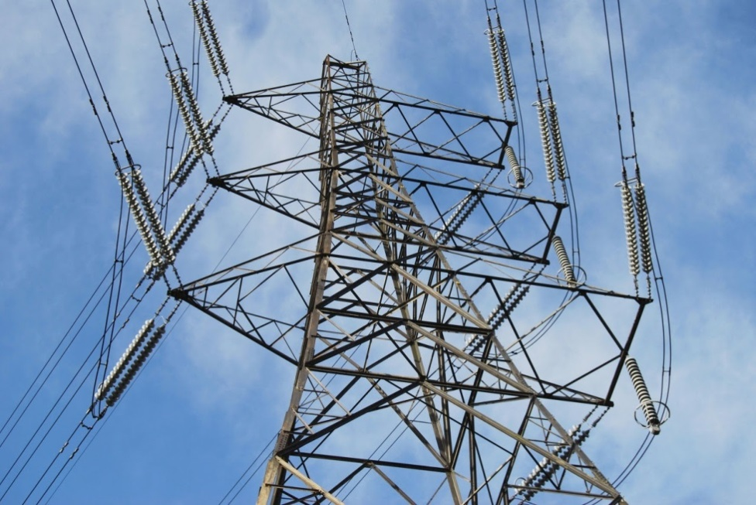
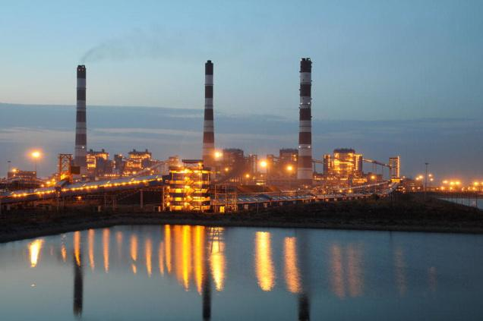
Energy Rich
Power-on-demand
– one among a handful of states in India
Cheaper electricity
– 35% cheaper than all India average

Slide 6
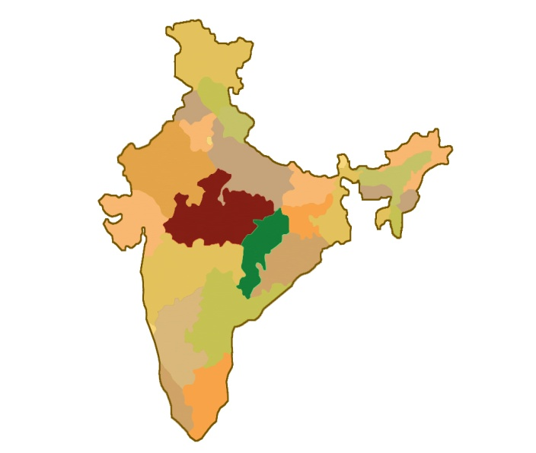
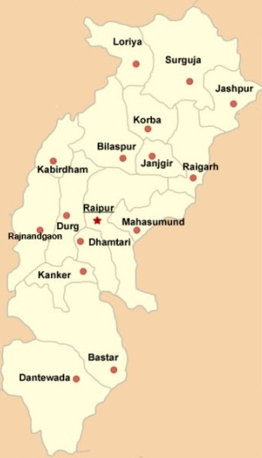
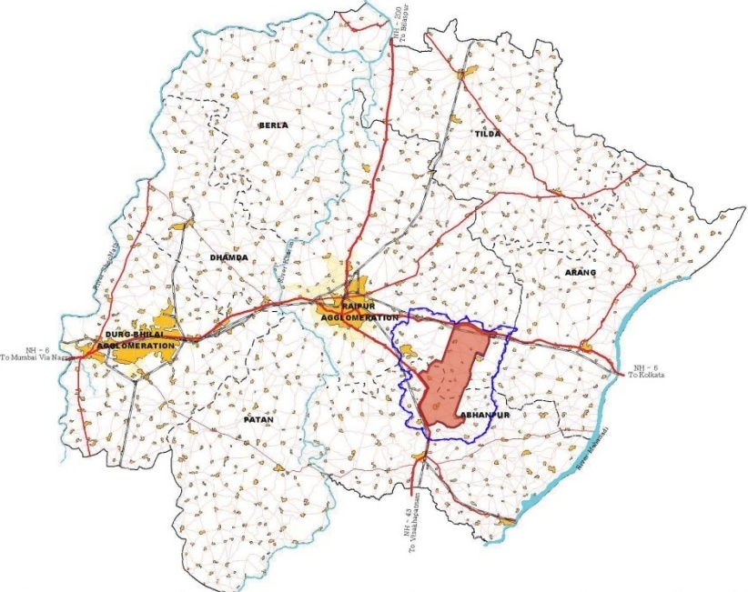
Naya Raipur
NAYA RAIPUR

Slide 7
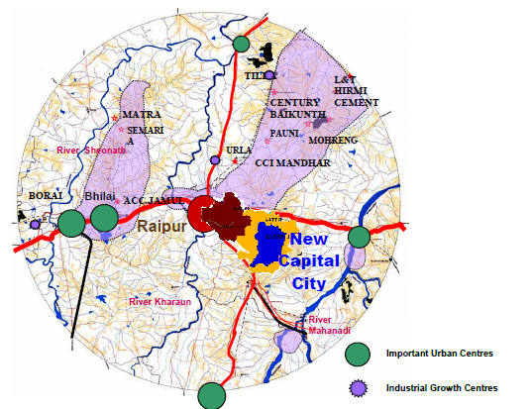
SITE SELECTION
The site selection and suitability analysis for the New City, has been done considering some of following parameter –
  Connected to NH-6 and NH-43,
  Railway link to Vizag, Mumbai
  Close proximity to Airport and major urban centres
  Maximum Government land
  Land unsuitable for agriculture, mining and quarrying
  Land having least number of existing human settlements
  Minimum forest cover and wild life,
  Water availability and easy drainage
  Soil having good bearing capacity.
Naya Raipur is at a distance of approx 20 kms from Existing Raipur City.

Slide 8
VISION
‘Naya Raipur’ to be developed as a modern but ‘green city’
For conservation of the environment and existing landscape, best practices for water harvesting, waste water recycling and use of non-conventional energy resources would be adopted
Naya Raipur designed as a citizen friendly and pedestrian friendly city.
City design would promote sense of security and comfort among its citizens, especially women, children and the physically challenged.

Slide 9
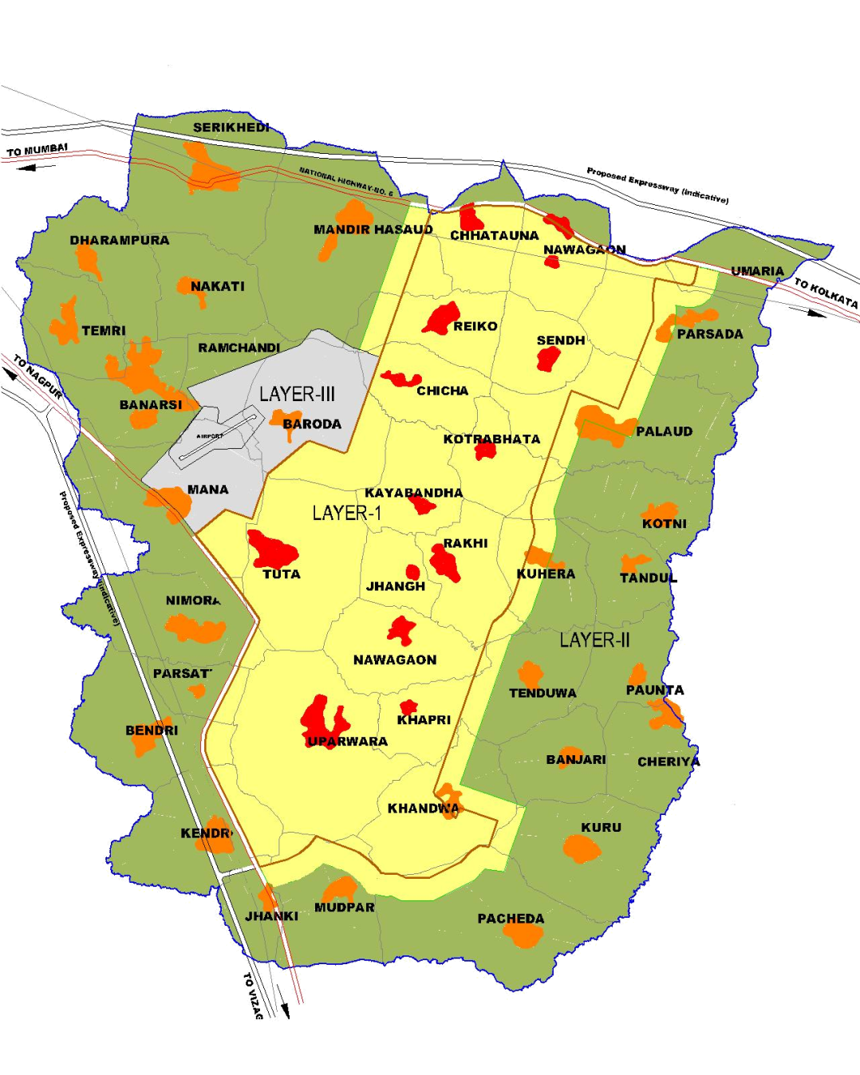
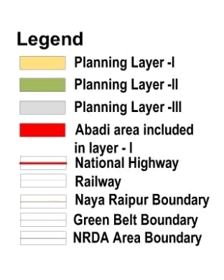
Naya Raipur Planning Area
The Development Plan-2031 consists of three layers-
Sr. No. | Layer | Area Included | Villages included
1 | Layer-I | Area–80.13 sq.km. | 10 fully and 22 partly
2 | Layer- II (Naya Raipur Peripheral Region ) | Area–130.28 sq.km. | 9 fully and 19 partly
3 | Layer- III (Airport Zone) | Area–11.92 sq.km. | 2 fully and 1 partly
13 Abadi areas have been included in layer -I

Slide 10
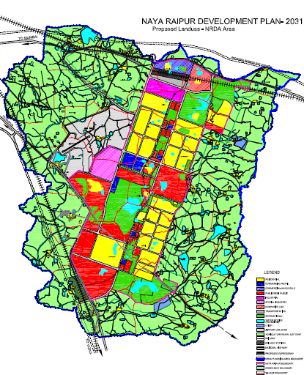
PROPOSED LAND USE
Land Use | % distribution
Residential | 26.37
Commercial - Retail | 1.81
Commercial - Wholesale | 1.63
Industrial | 2.42
Special Industry | 3.28
Public & Semi Public | 23.04
Recreational | 26.67
Transport | 12.55

Slide 11
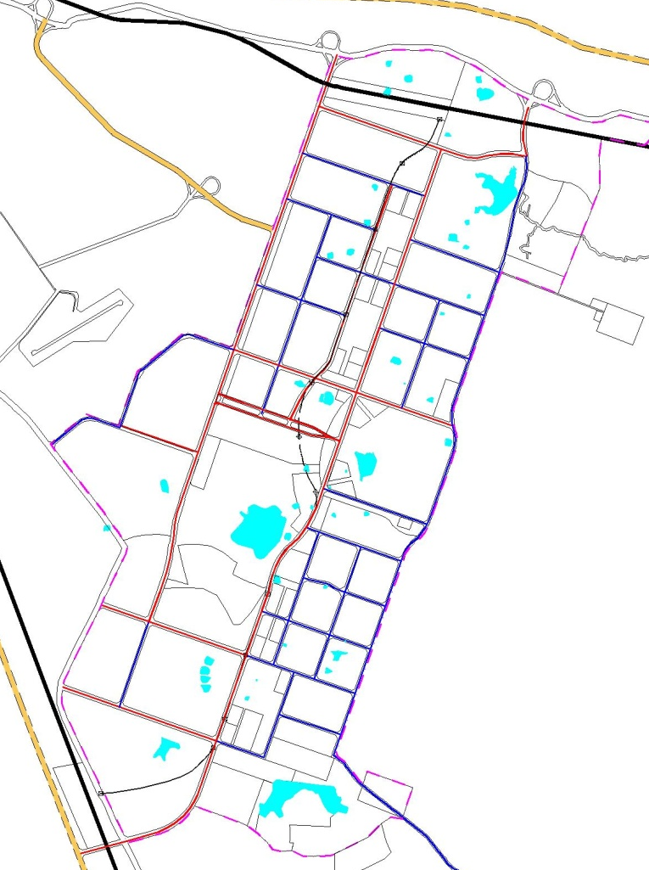
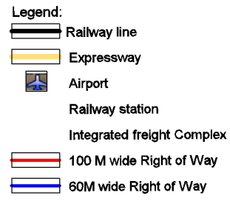
TRANSPORTATION
Durg – Mahasamund Expressway
Towards Mumbai
N.H. 6
Integrated Freight Complex
The transport system plan of Naya Raipur has been developed with the following Vision:
EXPRES WAY
Transport Hub
Towards Kolkata
‘Mobility of all, affordable, equitable and safe’
Airport
N.H. 43
Towards Nagpur
Dhamtari- Bilaspur Expressway
Proposed Railway Station
Towards Vizag

Slide 12
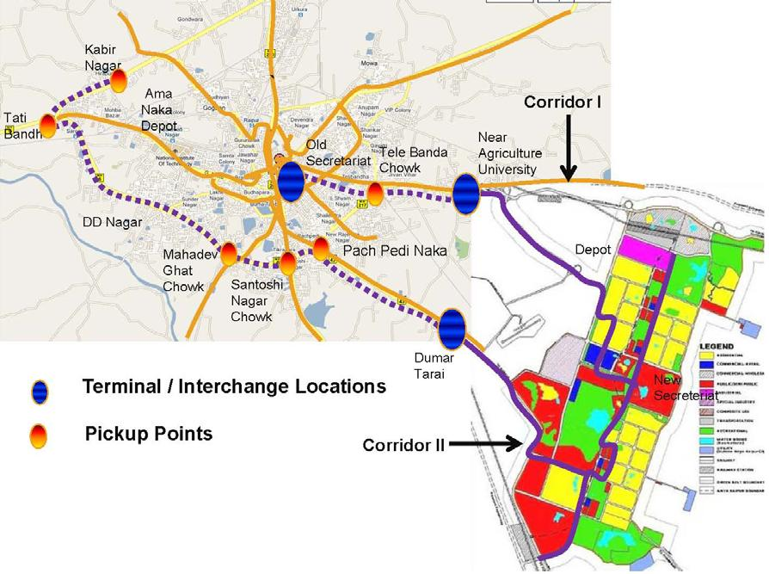
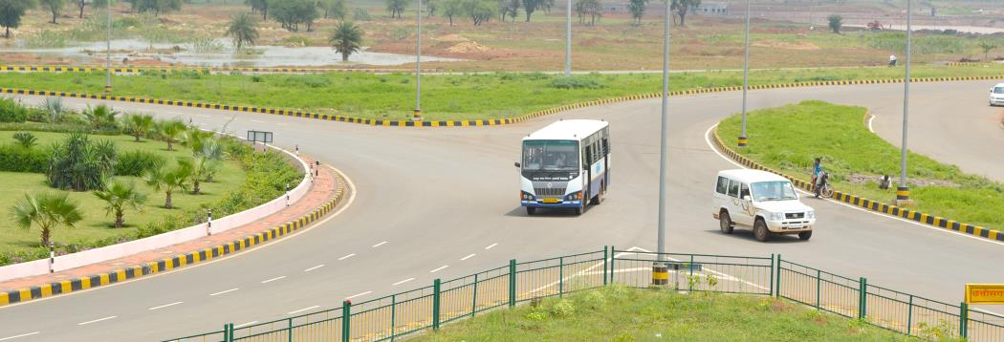
TRANSPORTATION
Public Mass Transport System
Bus rapid transit system (BRTS)
Light rail Transit system (LRTS)
Railways
Corridor III
Source: Bus Service Plan Report by EMBARQ

Slide 13
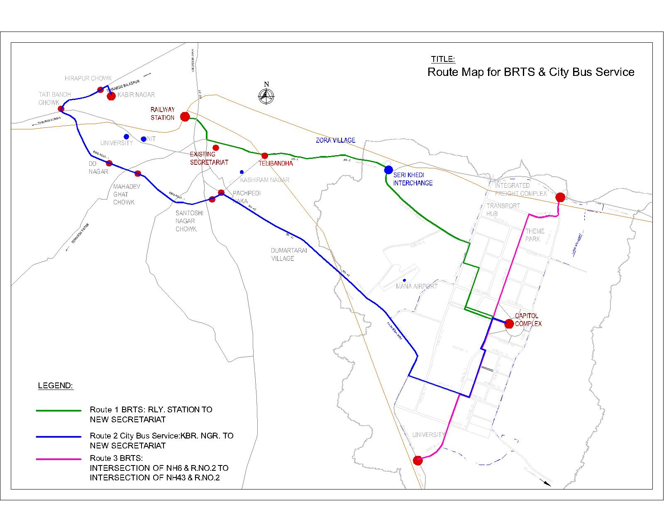

Slide 14
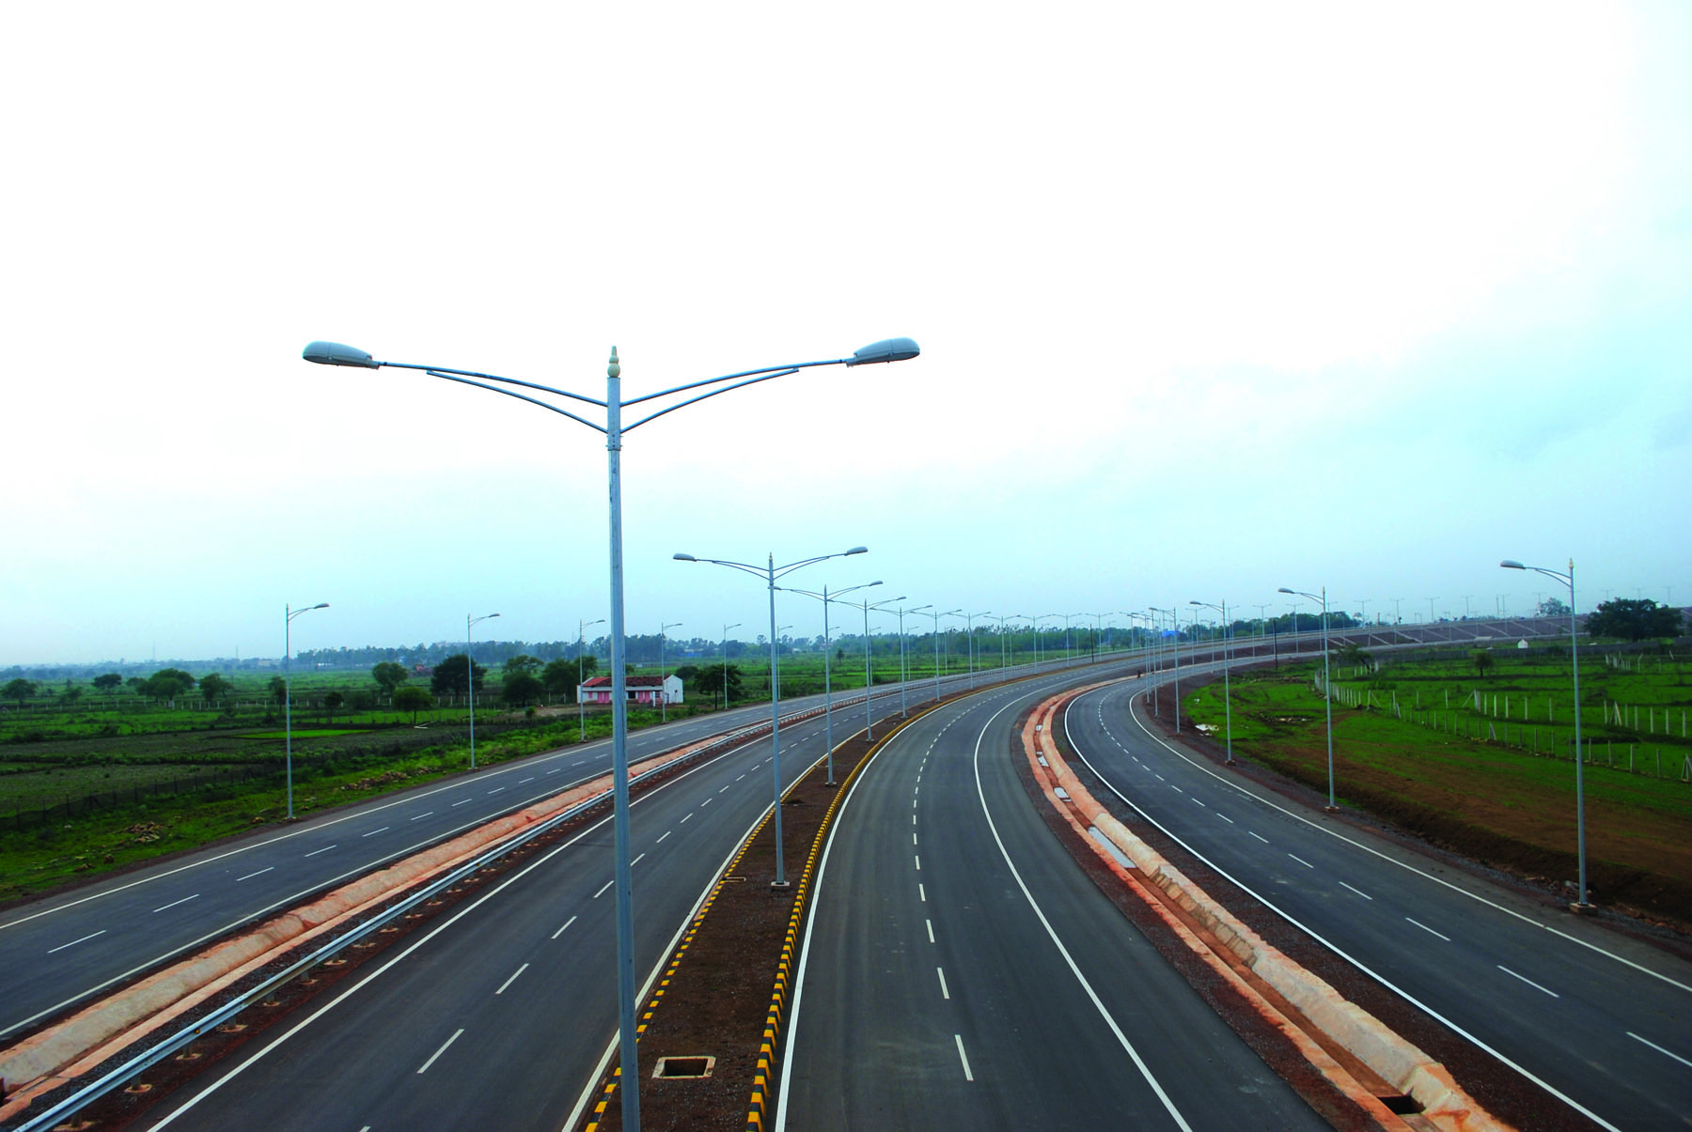
PHYSICAL INFRASTRUCTURE
ROAD CONSTRUCTION
TELECOMMUNICATIONS
Eight lane expressways will provide easy access to the city.
At present access is through NH-43 at the south- eastern boundary and NH-6 at the northern boundary of Naya Raipur.
Inner and outer ring roads will provide a consistent and streamlined traffic flow while decongesting the city. Nearly 75 kms of the 225 kms of proposed roadways has already been constructed.
Modern communication system will be provided for internal as well as external communication.
Electronic exchanges with 40,000 lines per exchange are proposed to be installed in requisite numbers.
Fibre optic cables will be used instead of conventional telecom cables.

Slide 15
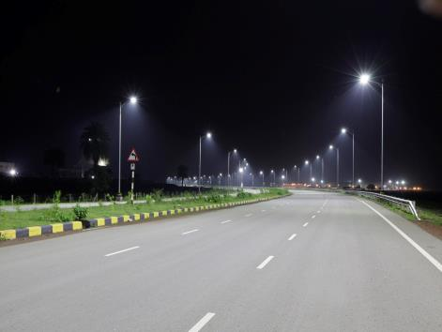
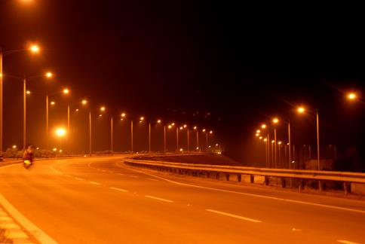
PHYSICAL INFRASTRUCTURE
ELETRICITY
The power requirement of Naya Raipur is to be met in three phases.
The city will have an underground power distribution system along with SCADA [Supervisory Control and Data Acquisition] to have online monitoring and control of power supply.
Non-conventional and alternative energy resources are being used to the maximum. Street lighting will see the use of latest technology like T-5 and LEDs.
Solar power will be used widely in administrative buildings, street lighting and traffic signals.
All power supply at city and section levels is underground. There are no hanging wires in the city.

Slide 16
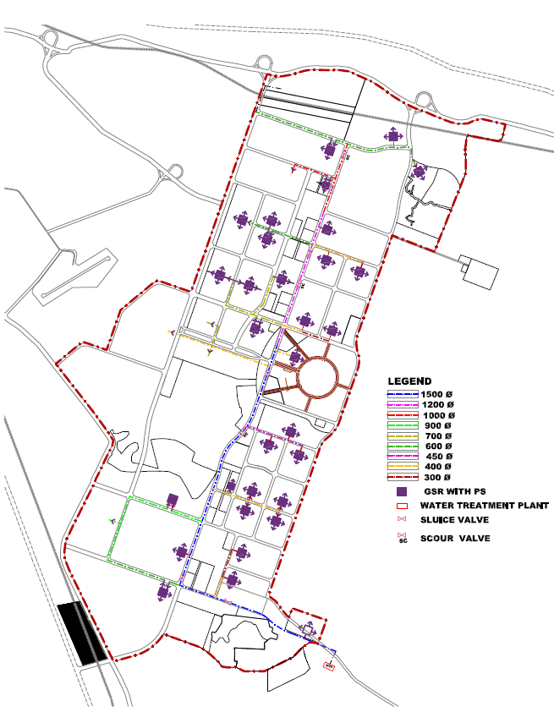
PHYSICAL INFRASTRUCTURE
Water Supply System in Naya Raipur
WATER SUPPLY
The water supply system focuses on water management products, processes and services that are economically viable as well as socially and environmentally acceptable, with specific measures for water conservation and waste water recycling.
The initial requirement for water is being met by constructing an anicut on the Mahanadi river near the village Tila.
The city water supply system in Naya Raipur is one of the few in India to work on the Public Private Partnership model [PPP].
PHASE WISE WATER SUPPLY DEMAND
Particulars | Phase I (2011) | Phase II (2021) | Phase III (2031) | Total
Population (current and estimated) | 150,000 | 365,000 | 560,000 | -
Capacity (additional modules of WTP) (in MLD) | 90 | 95 | 45 | 230
Total Water Supply Demand (in MLD) | 85.74 | 93.01 | 42.29 | 221.07

Slide 17
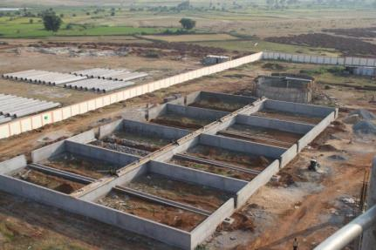
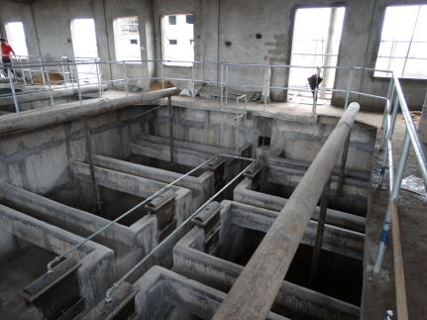
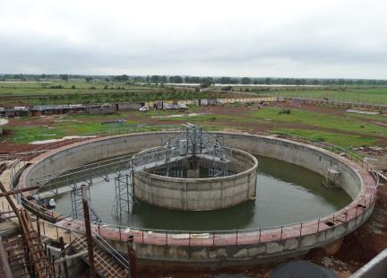
PHYSICAL INFRASTRUCTURE
SEWARAGE
Naya Raipur will have decentralised sewage treatment for better efficiency.
Sewage will be treated to the standards as prescribed by the Central/State Water Pollution Control boards, with maximum recycling and re-use of water for irrigation.
Drainage along roads will be provided without disturbing the major natural drainage channels.
The solid waste management system based on the PPP model will ensure proper selection of a waste disposal site; segregation of household waste; separate disposal of hazardous or bio-medical waste; and intensive tree plantation on disposal areas.

Slide 18
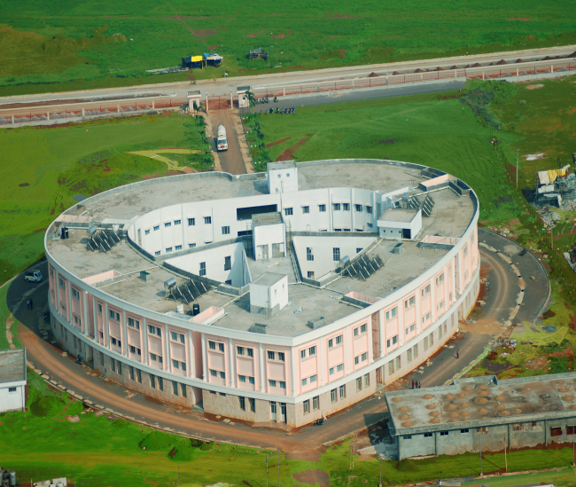
SOCIAL INFRASTRUCTURE
HEALTH FACILITIES
Provision of Health facilities from Dispensary to Super Specialty Hospitals
To provide world class health care in oncology and related fields.
To provide medical care at affordable cost to the people of Chhattisgarh and Central India.
To conduct India centric research in cancer and oncology professionals.
Establishes a 350 bed tertiary care hospital with state of the art facilities.
Satellite centres to ensure accessibility of treatment to masses.
Aims to provide adequate infrastructure to complement high academic standards of the medical & scientific faculty.
Satysaibaba Heart Hospital, Cancer Hospital anf AIMS are placed.

Slide 19
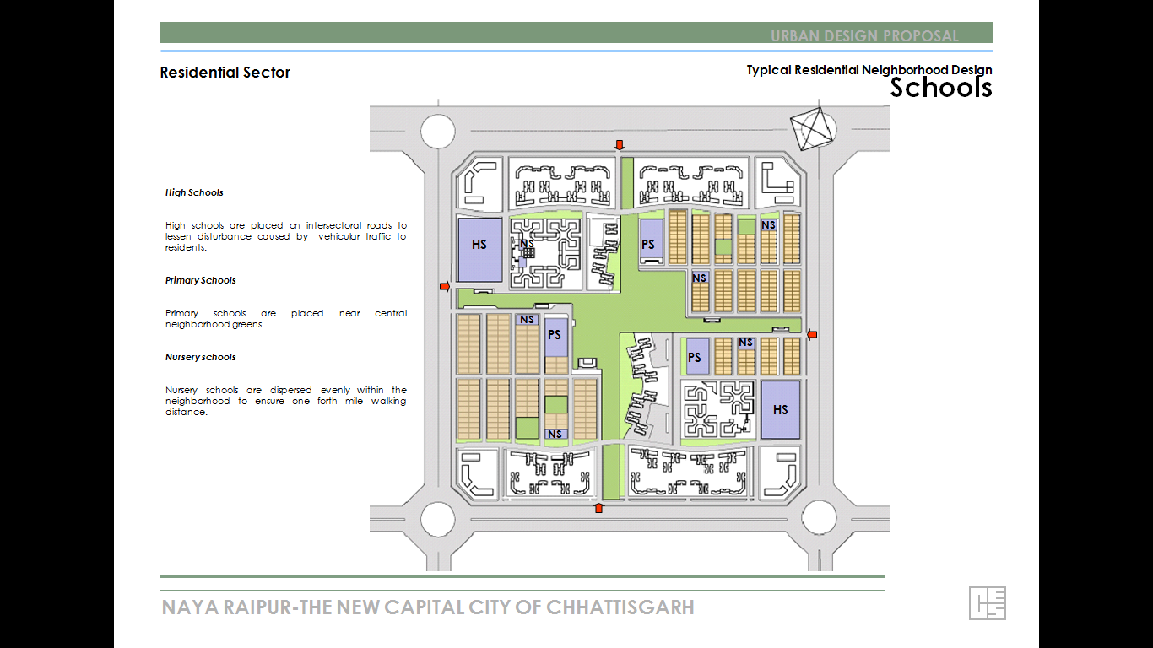
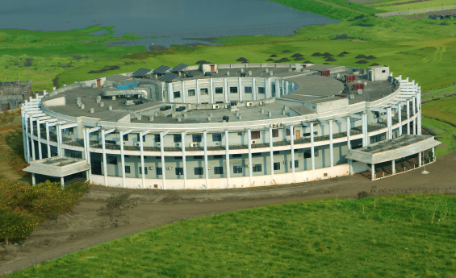
SOCIAL INFRASTRUCTURE
EDUCATION
Providing primary, higher secondary schools education to 100% children of the age group 6 to 18 yrs.
Integrated school with and without hostel facilities to be developed as public and other similar schools.
School for the mentally and physically disadvantaged.
Special areas have been earmarked by the NRDA to set up schools and colleges that will make Naya Raipur a knowledge hub.
An Ayurvedic University is being set up in the state of Naya Raipur as its headquarters.
Hidayatullah National Law University has commenced its courses in its new premises at NayaRaipur.
Land has been allotted to the Indian Institute of Management and the Indian Institute of Information Technology for two Ivy League grade institutions to blossom in the very near future.

Slide 20
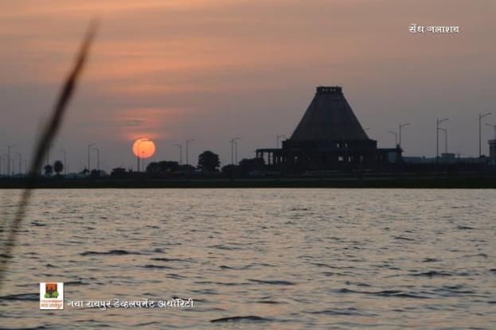
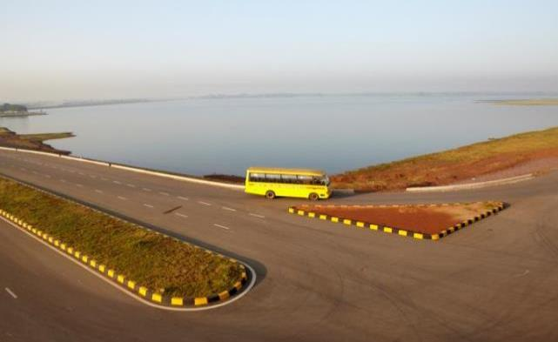
RECREATION
All Water bodies will be conserved in Naya Raipur.
Theme based development plan has been prepared with focus on intense landscape around each lake.
100 % rainwater harvesting.
Three main water bodies will be conserved and developed under following themes.
Lake 1 : JHANJH – Modern Recreation
Lake 3 : SENDH – Sports and Tourism
Lake 2 : KHANDWA: Natural Recreation
(Jungle Safari)
PRESERVATION
CONSERVATION
ACTIVITY
DEGREE OF INTERVENTION
ZONES OF DEVELOPMENT in all lakes’ vicinity

Slide 21
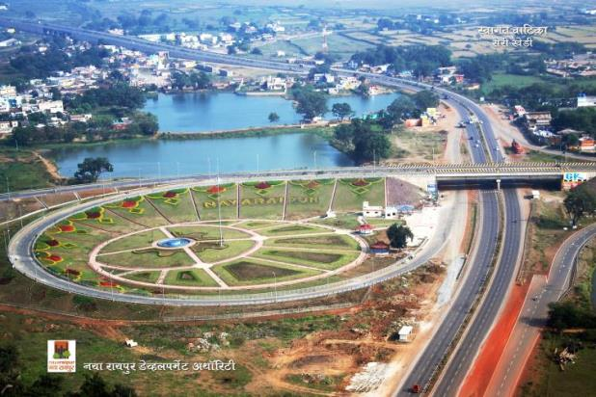
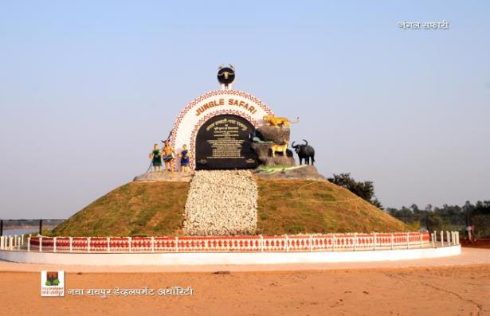
RECREATION
Recreational areas and open spaces are integral to the Garden City Image of Naya Raipur.
The central park in front of the Capitol complex area is being developed as more of modern, intense activity oriented having rejuvenating features.
Jungle safari is being developed in the area of ​​203 hectares.
Based on Geographic zone of India bio-art recreation facilities will also be available with a zoo.
An aquatic bird sanctuary in 18 hectares is being created in the Safari.
Khandwa Garden as floating garden in the reservoir is also being developed.
Golf Corse, Nature park, amd Snow Park through PPP mode

Slide 22
Phase I PLAN of Smart City in Naya Raipur
Surveillance.
Utility Management System.
Intelligent Transport System
Estate Management System
Command & Control Centre
Legal Framework to make the Smart City OUTPUT enforceable by law

Slide 23
Broad Scope of the PHASE –I Smart City Project
Track 1 - Surveillance
A. City surveillance system
Track 2 – Utility Management System (ICT-OP & MTNCE.)
A. Water Supply System- Intake to WTP &
Distribution Network
B. Power Distribution Network- UG with Ring-main.
C. Sewerage collection Network- STP & Recycle Water.
D. Intelligent street lighting systems -LED
E. Electrical charging stations.
F. Storm Water Drainage system.
G. Solid Waste management System.

Slide 24
Track 3 – Intelligent Transport Management System
A. Intelligent Transport System
B. Intelligent Parking Systems
C. Displaying real time information @ Traffic & Mass Transport. D. Intelligent Signalling System
Track 4 – Land & Estate Management System
A. Real Time information @ Land Ownership, property Tax, user Charges for each parcel.
B. Citizen Interface- online
Track5- Command & Control Center
A. Single Command and Control Center for the Smart City.
B. Emergency Response Mechanism
Track5 Regulation to make the Smart City OUTPUT enforceable by law

Slide 25
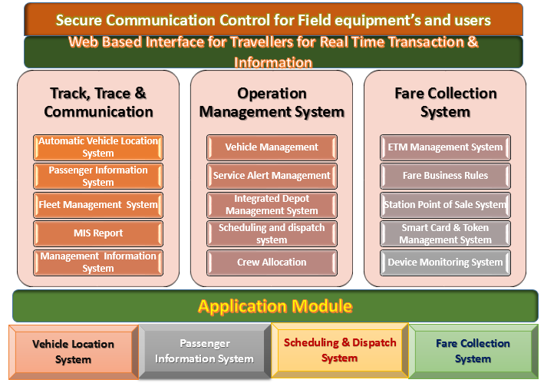
Intelligent Transport Management System for BRTS

Slide 26
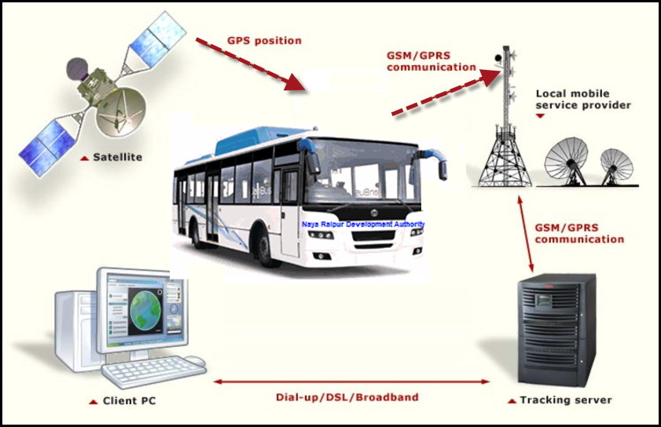
NAYA RAIPUR ITS CONCEPT: Track & Trace Communication System
    Vehicle Location System
    The Vehicle Location System will use GPS based VTU mounted on the vehicle for monitoring & tracking purposes.
    The GPS based AVL System will facilitate public information system to act as a source of information to be displayed on the public display screens and voice based information. It will -
Improve bus on-time performance and service efficiency
Reduce passenger waiting time
Provide customers with real-time service information.
Improve safety on buses and
Improve response times to incidents and emergencies.

Slide 27
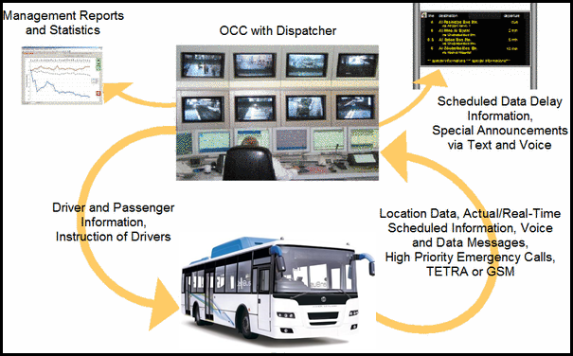
TRACK & TRACE COMUNICATION SYSTEM
    PASSENGER INFORMATION SYSTEM
Passenger Information System will consist of display system for bus stations/terminals. The system will offer –
Commuter schedule and real-time information regarding operations of bus service and
Extend ease of information delivery related to travel display screen on BRTS stations:
Display screen on buses/stations/terminals
Voice announcement system on buses
Web portal for bus schedule & ETA (expected Time of arrival)
SMS based traveller Information
Mobile apps based traveller information

Slide 28
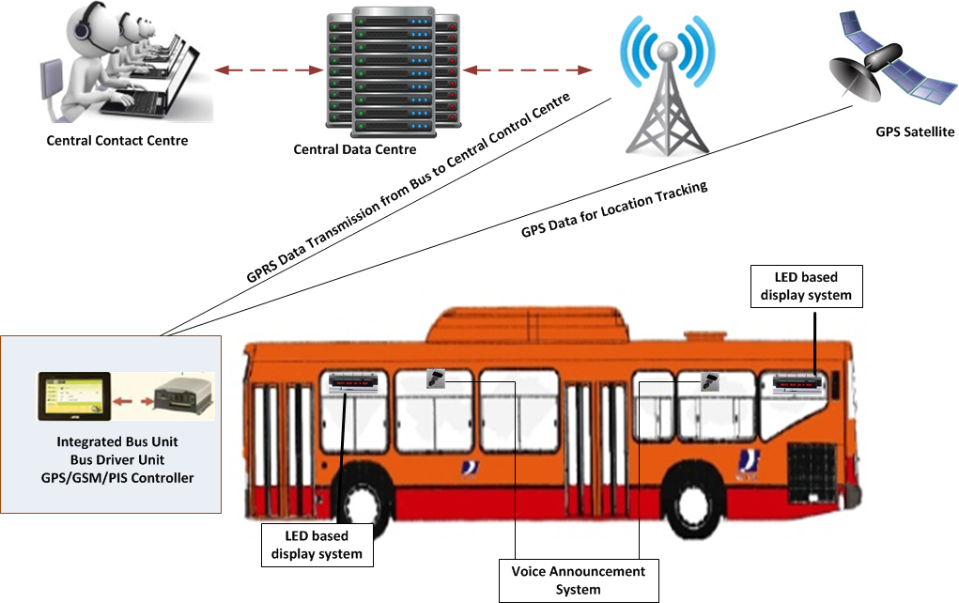
GPS BASED VTU & DISPLAY BOARD
The GPS/GPRS based VTU is an integrated control unit which will control the in bus display boards as well as the announcement system.
A bus may have up to four display boards (LED/LCD) mounted inside to display the upcoming Bus Stop & other relevant information. The components inside bus shall be as follows:
GPS based VTU and PIS controller device
Front Display Board
Rear Display Board
Side Display Board and
Internal Display Board

Slide 29
VIDEO SURVEILLANCE SYSTEM
Video surveillance system shall provide transportation security by cameras on buses and bus stations.
IP based cameras will be installed at the bus stations and buses to extend capability of video surveillance to BRTS system. The buses will be installed with minimum of 2 cameras and could be extended to 4 depending on the requirements identified by the operations team.
The bus stations will be installed with 2 cameras in standard size BRTS station and in bigger formats the number of camera requirement will be determined based on the operations requirement.
The station and buses will be equipped with local DVR system to store video and the same will be available to central control centre based on the requirement identified by the operations team. The DVRs will have capability to store minimum one month of video records for audit purposes.

Slide 30
INTEGRATED DEPOT MANAGEMENT SYSTEM
The Integrated Depot Management System (IDMS) shall enable automation of depot Operations.
It shall include workshop management, fuel management, traffic management, vehicle management, workforce management.
The IDMS will have a module for fleet management and maintenance. The maintenance module will ensure that the vehicles are in operable conditions and the availability of the rolling stock is always high.
The IDMS system will have modules which integrate and deliver critical functions related to maintenance of the buses, management of human resources like driver, time keepers/traffic controllers and ticket inspectors, who are critical for timely operations of public transport fleet.

Slide 31
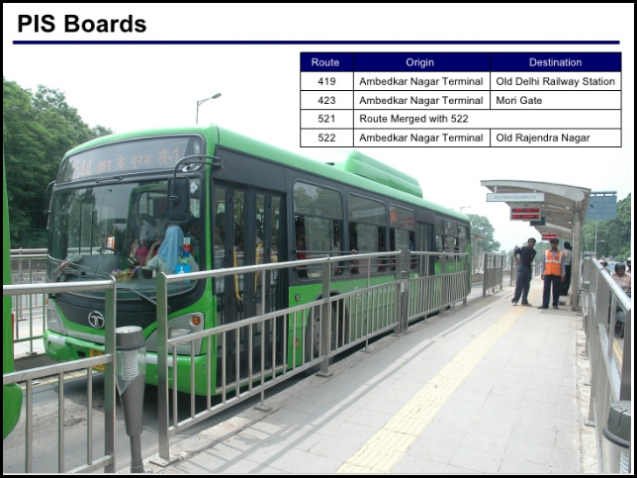
PASSENGER INFORMATION DISPLAY
The PIS display terminals will be installed at various locations for the purpose of displaying ETA/D of BRT buses.
The stations will have 2 number of LED based display terminals at the either end of the bus station.
The display devices installed on the stations will primarily deliver ETA for the buses and also important information for public consumption.
The mobile and web system will allow the commuters to query based on origin-destination and the system will deliver real-time information.

Slide 32
BUS STATIONS: RFID CONTROLLED PLATFORM GATES
Automated Boarding Gates and Electronic Docking System shall ensure safe boarding and alighting services at the BRTS bus stations.
The system is designed to work only in safe operating conditions and shall be operated by the driver using wireless control switch.
The Automatic Sliding Doors in the platform shall operate only when bus door aligns completely with the bus station door with the help of RFID Docking reader in the bus station and RFID Tag inside the bus and when Driver presses the RF switch.
RFID docking reader will be installed at suitable height and distance ahead of the automatic sliding door in the bus station so that RFID tag inside the bus is in the close range when the bus door and bus station doors are aligned.

Slide 33
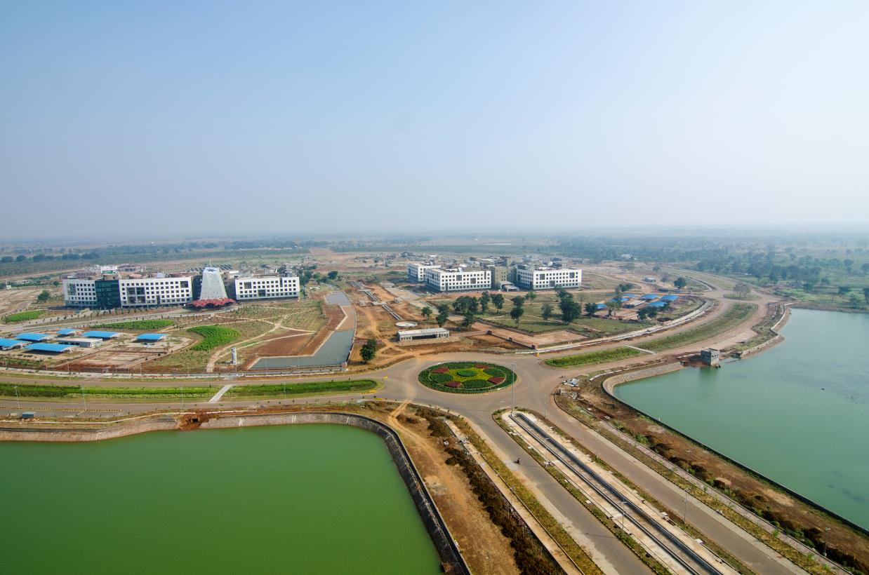
Snap Shots -------AERIAL VIEW

Slide 34
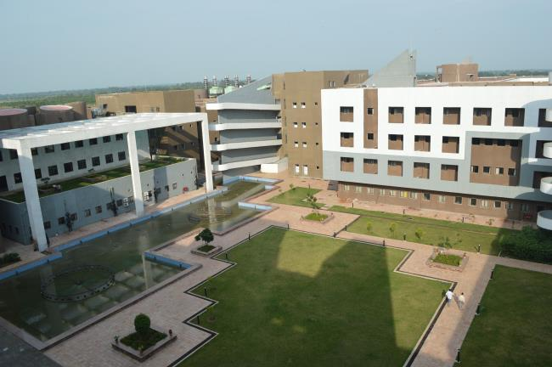
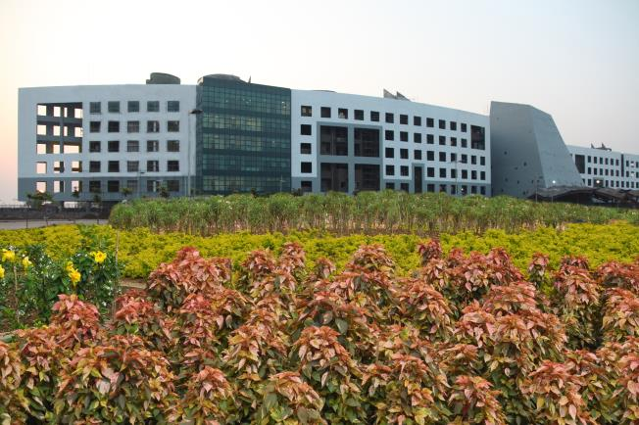
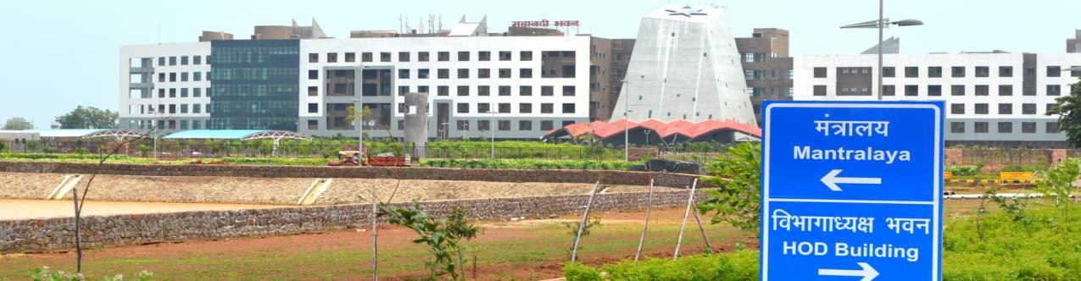
CAPITOL COMPLEX

Slide 35
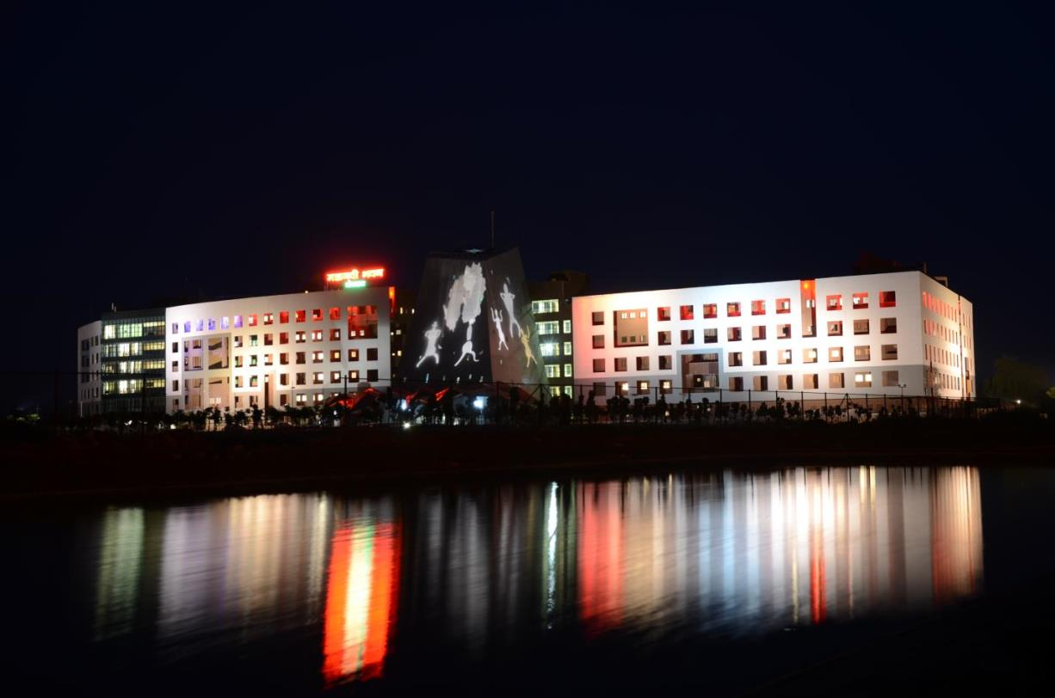
CAPITOL COMPLEX

Slide 36
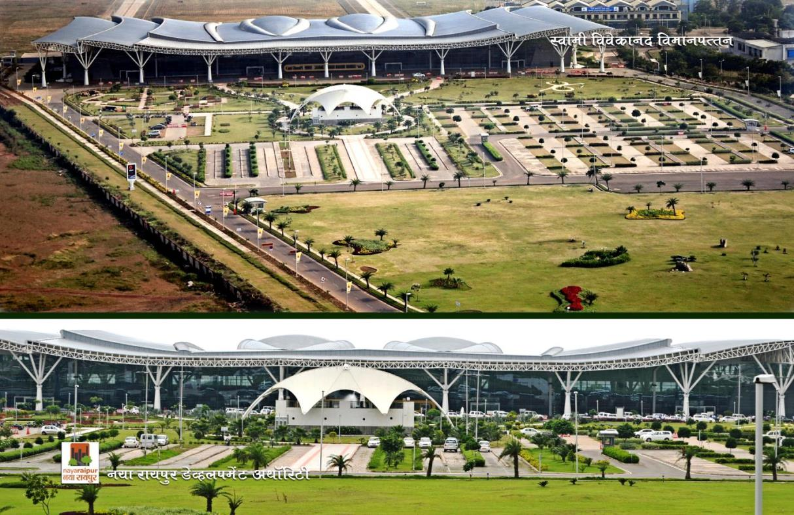
AIRPORT – NEW TERMINAL

Slide 37
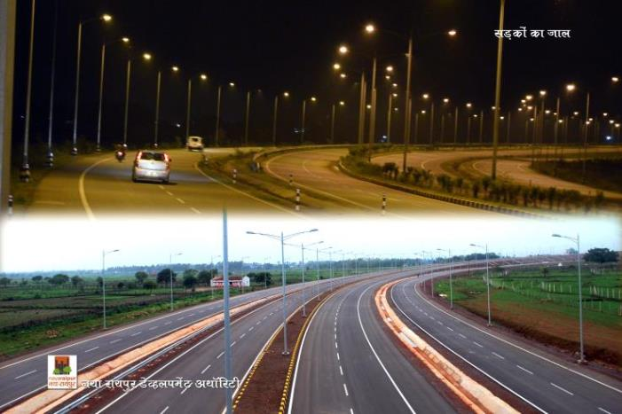
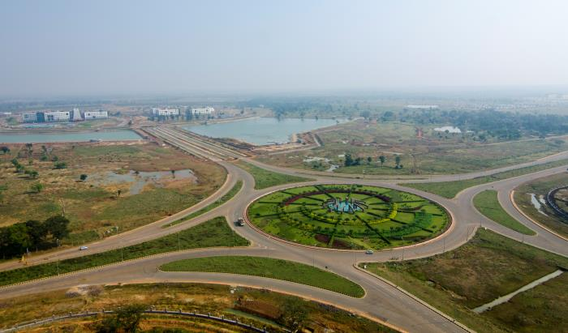
ROADS

Slide 38
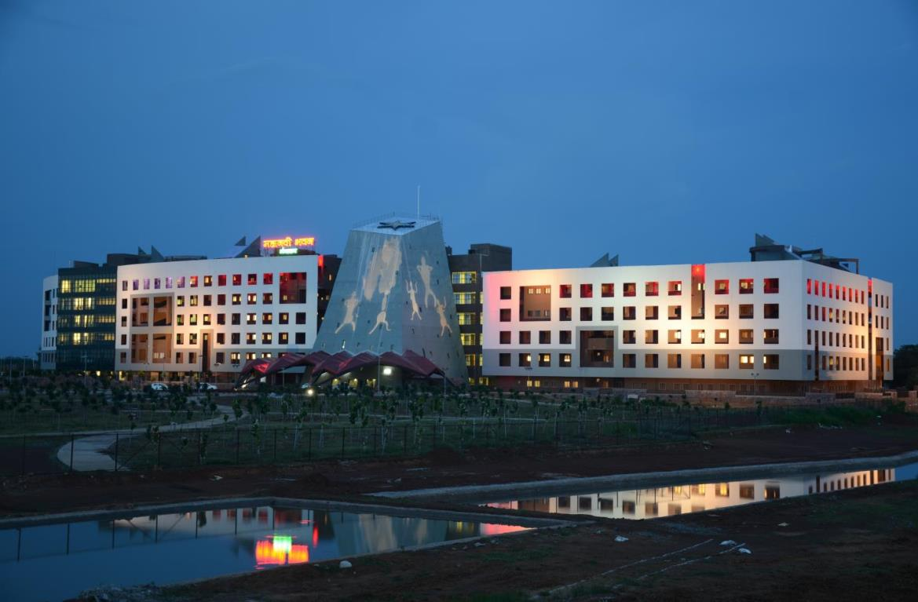
NIGHT VIEW

Slide 39
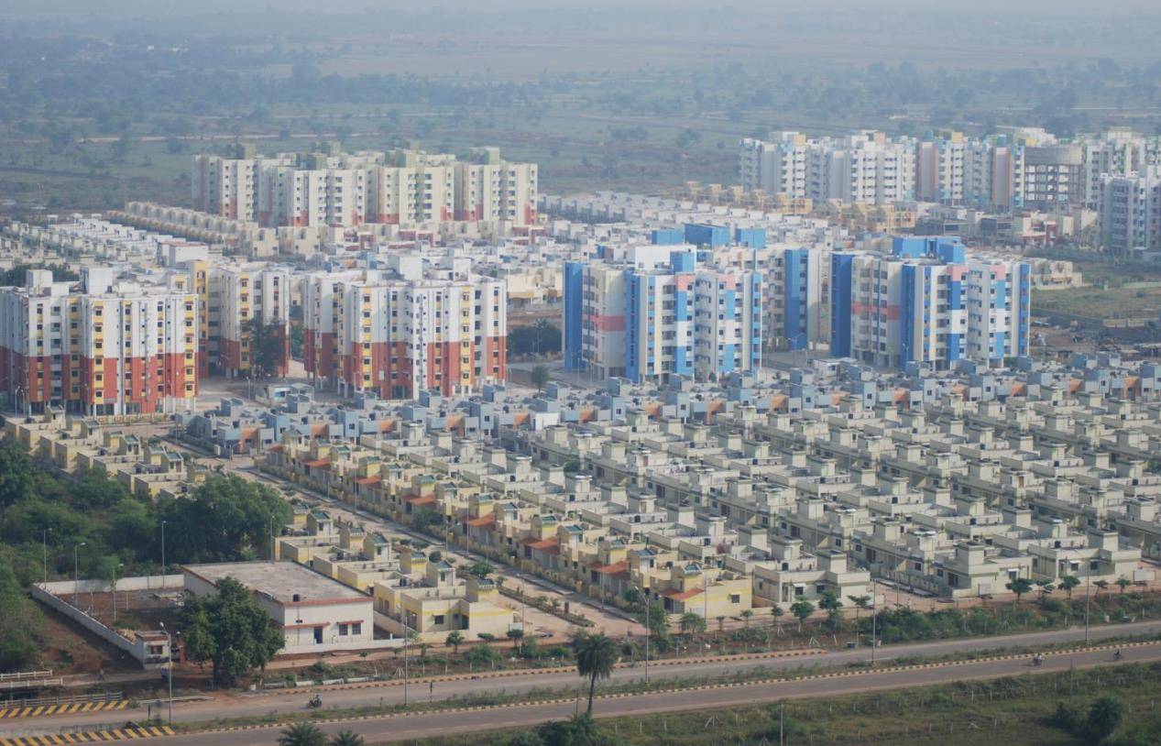
AERIAL VIEW

Slide 40
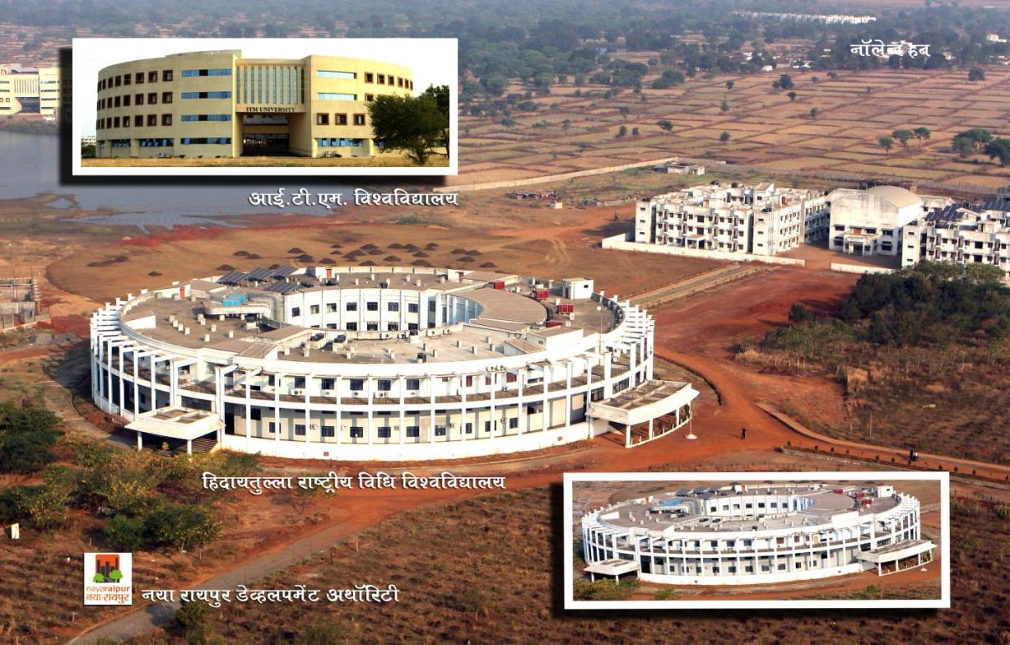
UNIVERSITIES

Slide 41
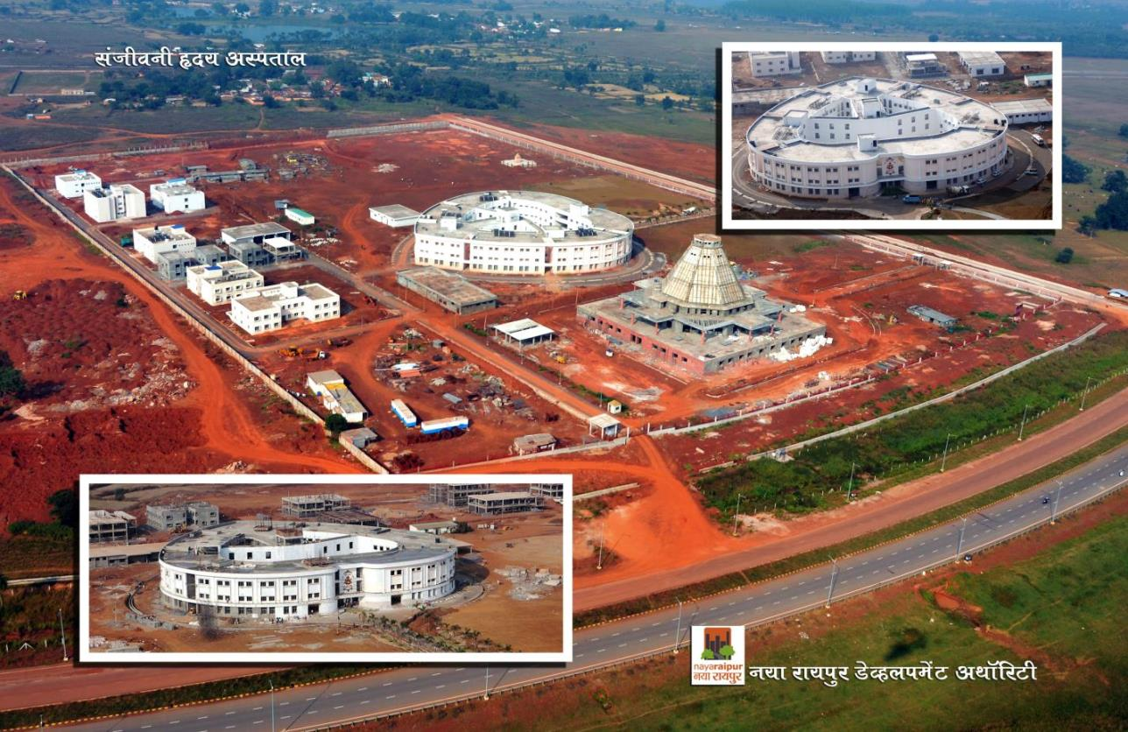
HOSPITALS

Slide 42
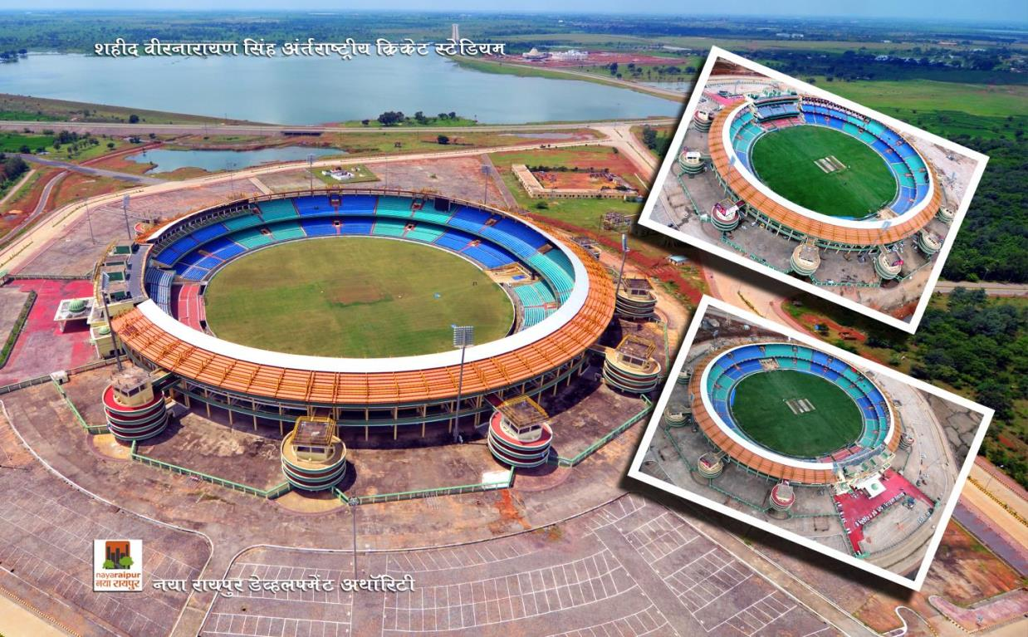
CRICKET STADIUM

Slide 43
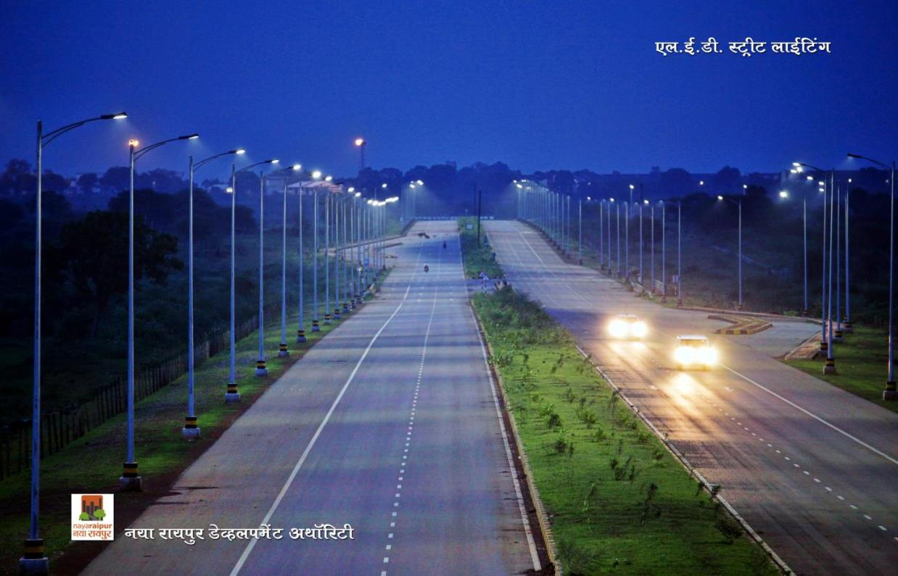
LED LIGHTING

Slide 44


Slide 45
THANK YOU
For Details Visit
www:nayaraipur.gov.in

Slide 46
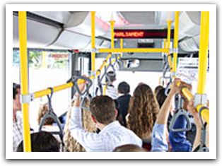
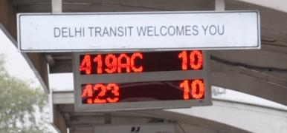
TRACK & TRACE COMUNICATION SYSTEM
AVL System & PIS Components
The AVL system comprises of following important components:
GPS/GPRS based Vehicle Tracking Unit(VTU)
Backend Control System (Including application software, maps and IT hardware)
B. The PIS comprises of following important components:
On-board Vehicle Passenger Information System
Off-board Passenger Information System at stations/ terminals

Slide 47

BUS STATIONS
At Bus Stations, passengers can easily view bus arrivals and departures schedule as well as schedule changes, service advisories, etc.
The BRTS station will have hardware, software and communication components to offer services related to fare collection, PIS services and passenger management.

