Slide 1
Gujarat International Finance Tec – City
A Global Financial Hub
Notes:
1
1

Slide 2
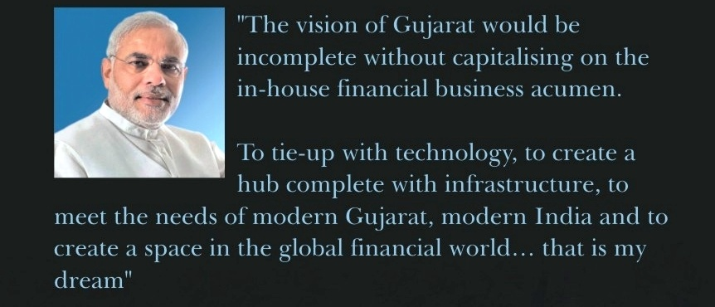
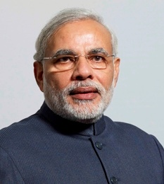
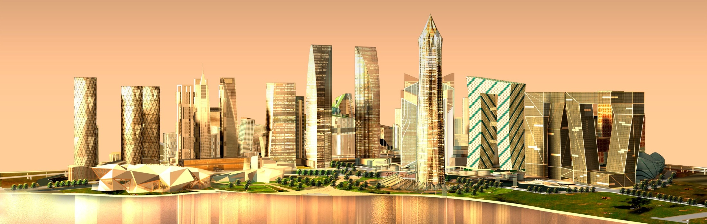
    Shri Narendra Modi
    Hon’ble Prime Minister of India

Slide 3
Need of Global Financial Hub in India
    Significant Potential:
  Financial Services Sector transformed over the last decade
  Sector contributes significantly to the Indian economy
  Employs over 4 million people and likely to grow around 10-11 million by 2020
  Represents around 5% of the GDP and will grow to 15% by 2020
  Estimated market capitalization of over US$ 300 billion and likely to grow over US$ 1600 billion by 2020
  Offers distinct kinds of opportunities across several product markets
    “Given India's continued economic growth, the financial sector will grow increasingly larger, with a prospect of 10 to 11 million jobs by 2020.”

Slide 4
    Why Gujarat?
  GUJARAT’S STRENGTHS
  Traditional business community
  High growth economy-- >10 % over last five years
  Pool of trained manpower
      CAs
      Commerce graduates
  Active Capital Markets-- >Gujarat contributes 30% of stock market capitalisation
  Proactive Government
  43% urban population envisioned to be 50% by 2015
  KEY COMPETITIVE FACTOR
  People - Gujarat has an adequate employable pool and offers high potential for inward migration
  Business Environment - Gujarat has demonstrated successfully its forte of providing conducive business environment
  General Competitiveness - Overall, the state stands tall
Notes:
4

Slide 5
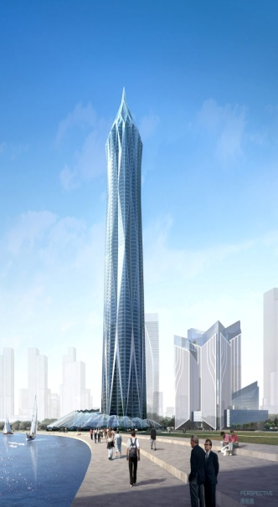
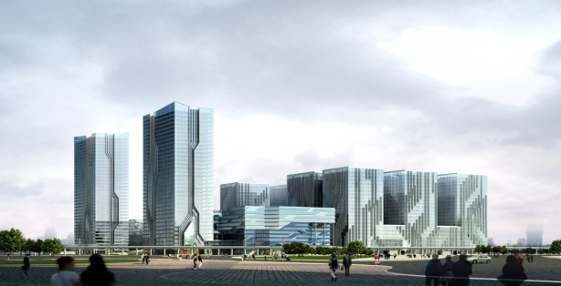
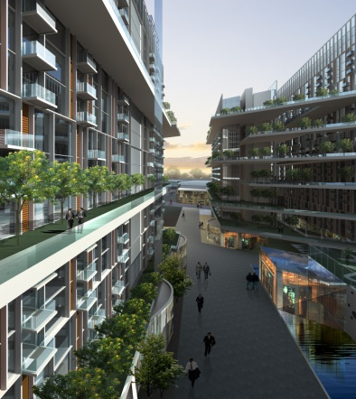
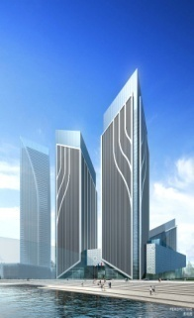
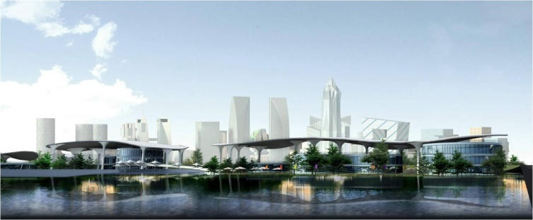
    GIFT- An Integrated Smart City
    A Global Financial Hub
  Globally benchmarked International Finance Centre
  Strategically located
  Central business hub 0.5 Mn direct & 0.5 Mn indirect jobs
  Targeting Financial Services & IT/ITeS sectors
  First of it’s kind development in scale, scope and quality
  State-of-the-art infrastructure
Notes:
5
5
1

Slide 6
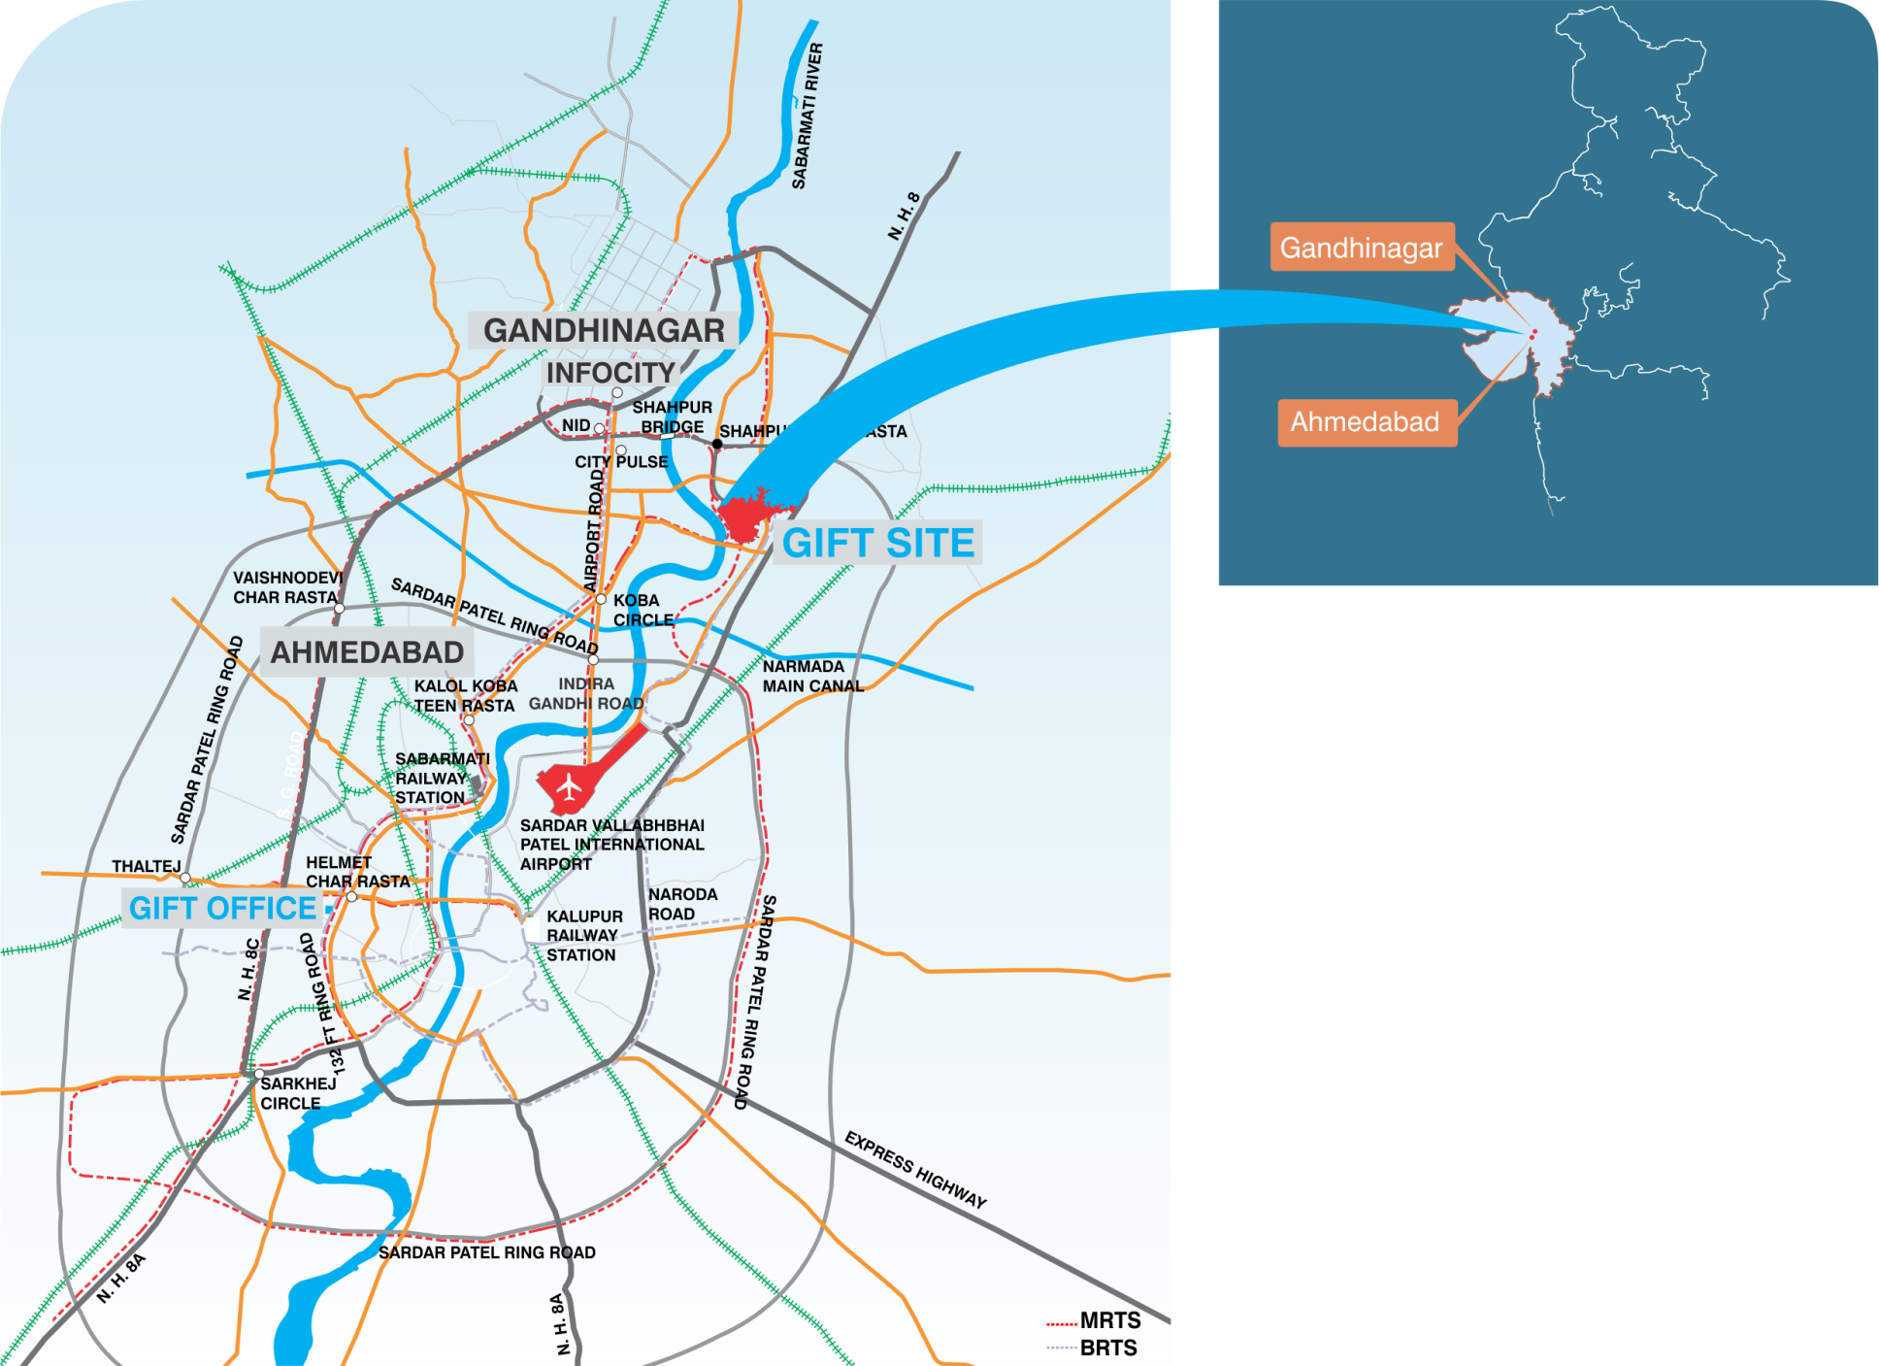
    Strategic Location - India / Gujarat
Delhi
DMIC
Mumbai
  Centrally located in the state of Gujarat in Gandhinagar
  12km From Ahmedabad International Airport
  On the bank of River Sabarmati
Notes:
6

Slide 7
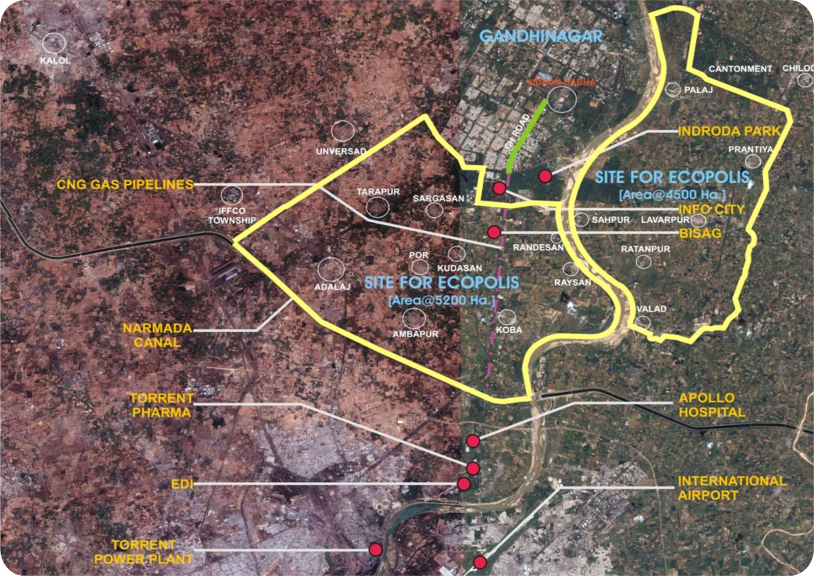
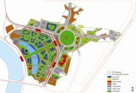
Master Plan Area : GIFT Will Spur Development
In The Region
Integrated Townships
GIFT
Expansion Zone
GIFT
Knowledge City
GIDC CONVENTION CENTRE
RIVER FRONT DEVELOPMENT
Notes:
7
1

Slide 8
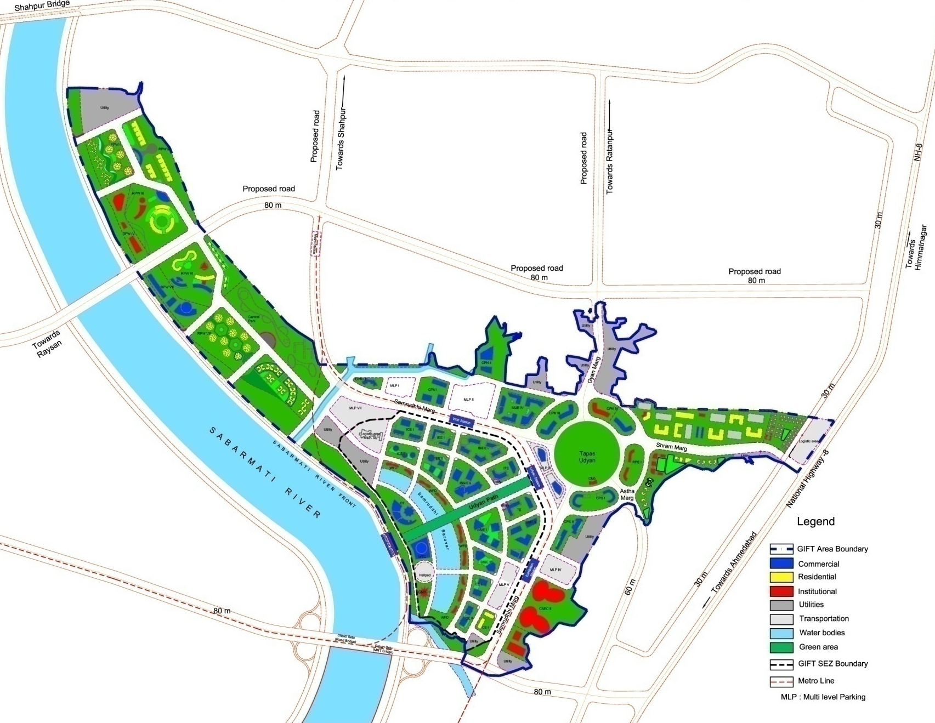
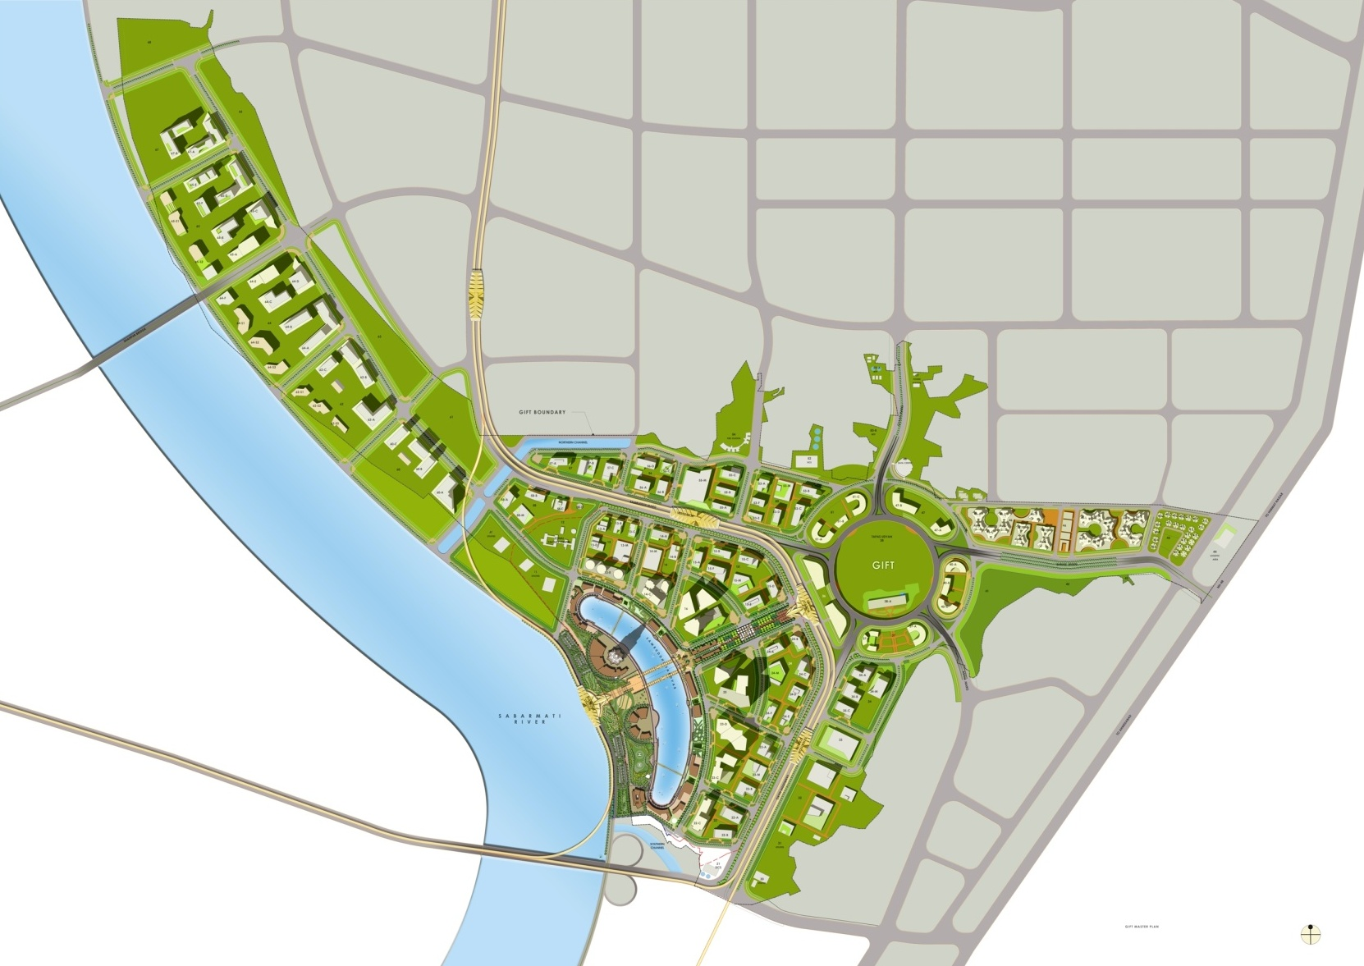
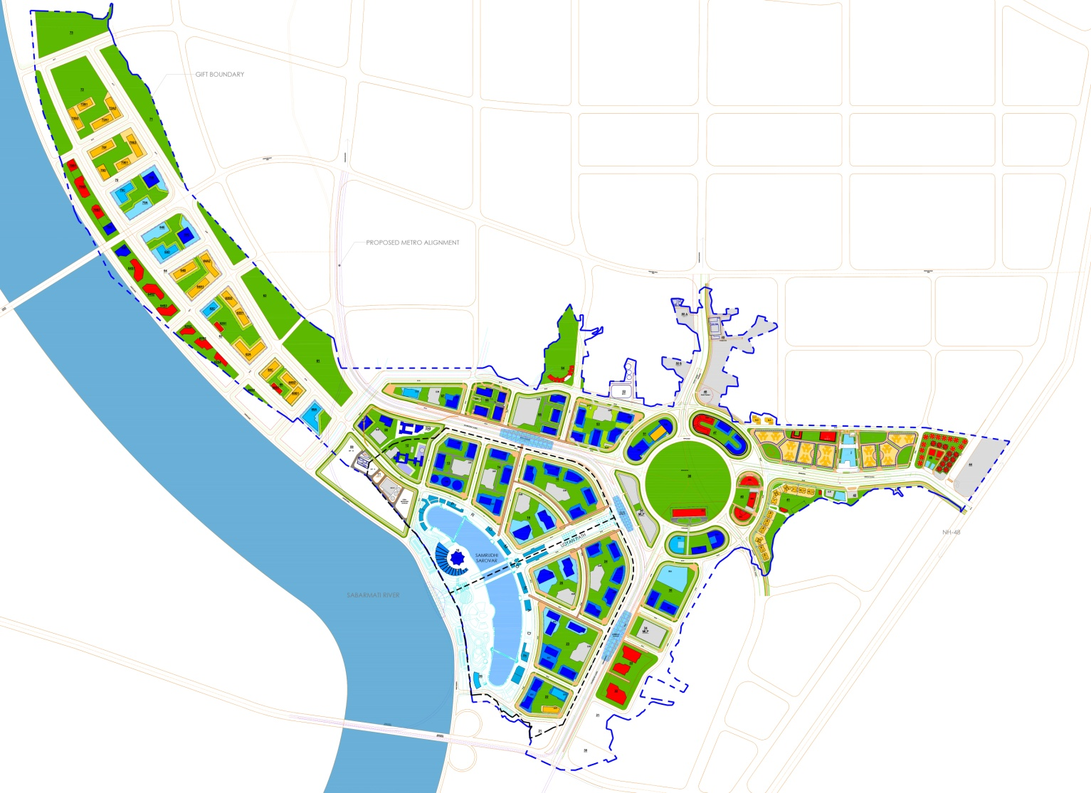
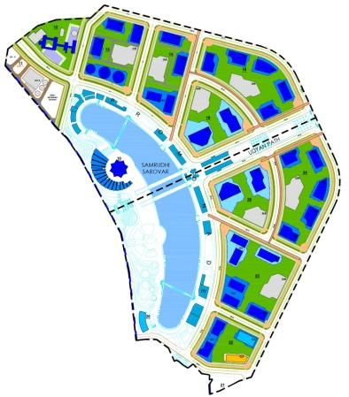

    GIFT: Master Plan
BUA : 62 mn.sq.ft.
Additional 22 Million to be developed after removal of height restriction by AAI
Existing Shahpur Bridge
Bapasitaram Junction
Building Use
Commercial : 67% (42 Mn SqFt)
Residential : 22% (14 Mn SqFt)
Social : 11% (6 Mn SqFt)
Access Road
Processing area
SEZ
Non-Processing area
SEZ
Bridge under Construction

Slide 9

    GIFT Development Structure
Domestic
Finance Centre/ Corporate Office/ Trade Centre
Multi Service SEZ with IFSC Status
Associated Infrastructure, Housing and
Social Facilities

Slide 10
    Buildings in GIFT
  110 Buildings
  1 Tallest building above 400m
  2 Landmark Buildings (Height- above 350 mt)
  18 Buildings (Height- 150 mt to 300 mt)
  73 Buildings (Height- 100 mt to 140 mt)
  2 Schools – International and Domestic Board
  200 Beds Hospital
  Hotels (5000 rooms)

Slide 11
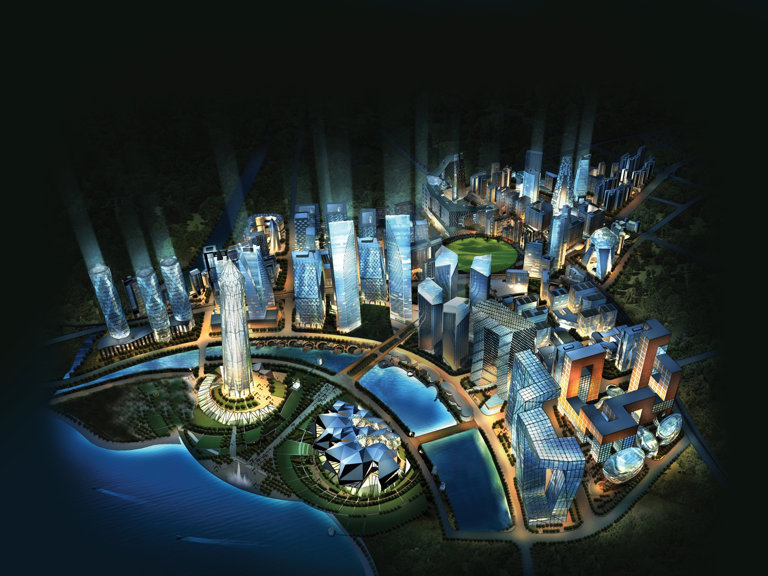
    GIFT: Bird Eye View
Notes:
11
1

Slide 12
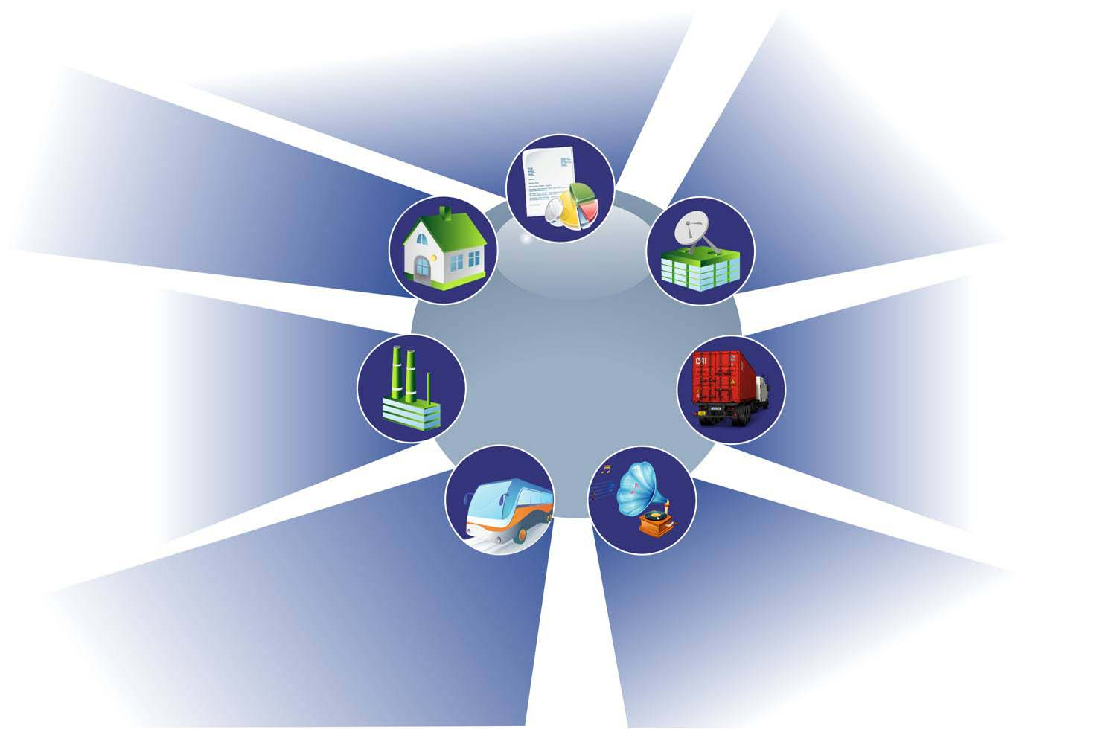
    GIFT an Integrated Urban Development
Smart Business Environment:
Benchmark office, high-rise district with landmark buildings
Technology:
Broadband FTTP
WiFi / Wimax
Shared IT Services
Global Connectivity
Integrated Residential Development:
Well-planned residential housing projects
Walk-to-work
Social Infrastructure:
International Exhibition Complex
Educational Institutes
International and Domestic schools
State of the Art Hospital
Training School
5 star Hotels and Business Club
PROACTIVE
URBAN GOVERNANCE
Smart Infrastructure:
Uninterrupted and highly reliable power supply (99.999%)
Next generation water & waste management, district cooling
Overall Connectivity/ Transport:
External Connectivity includes MRTS / BRTS/ Roads
Public-Private Modal Split 90:10
Retail Cum Entertainment Hubs:
High quality entertainment malls
Large river front entertainment development
Over 60% of the green Space
Notes:
12
1

Slide 13
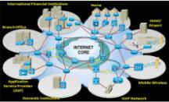
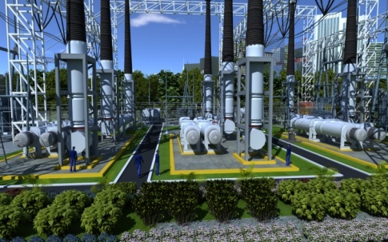
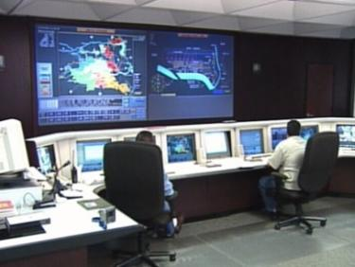
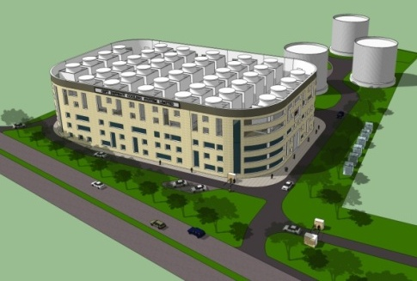
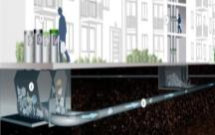
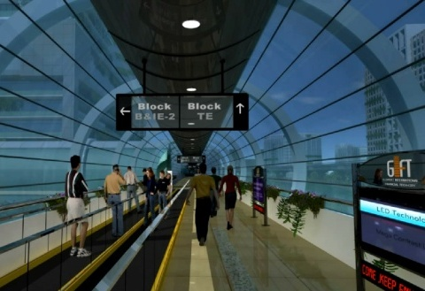
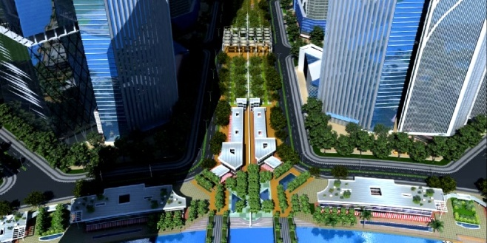
    GIFT Smart Infrastructure – Physical
Integrated infrastructure for better diversity
Smart Technology ensuring energy conservation
All utilities /services to be coordinated through single agency
INFRASTRUCTURE FACILITIES/ SERVICES
  Roads and Transportation
  Water Systems
  ICT
  Power Generation and Distribution
  District Cooling System
  Domestic Gas Distribution
  Waste Management Systems
  Utility Tunnel
  Landscaping
Notes:
13
13
1

Slide 14
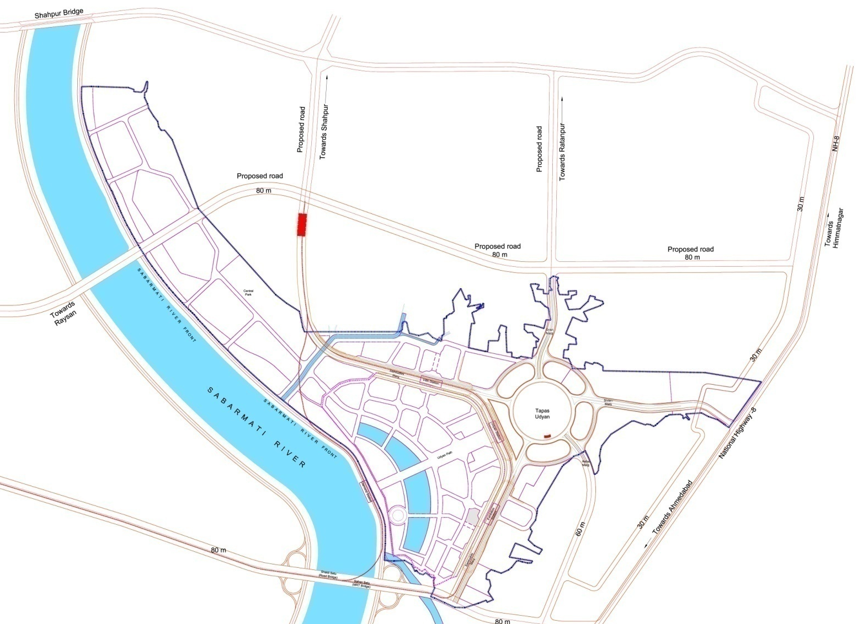
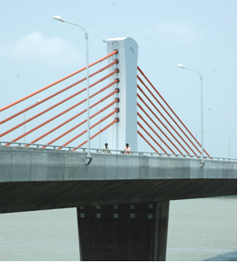
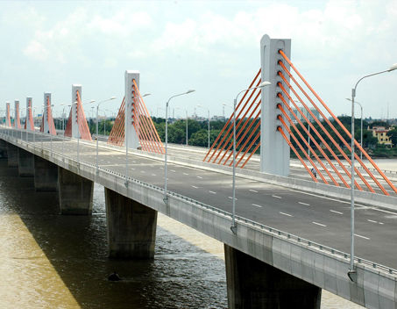
    External Road Connectivity
    by Govt. of Gujarat
Existing Bridge
Road -ID
Road -IA
Towards
Shapur
Towards
Ratanpur
Road -IB
Towards
Himmatnagar
NH-8
Towards
Raysan
Towards
Ahmedabad
Southern Bridge

Slide 15
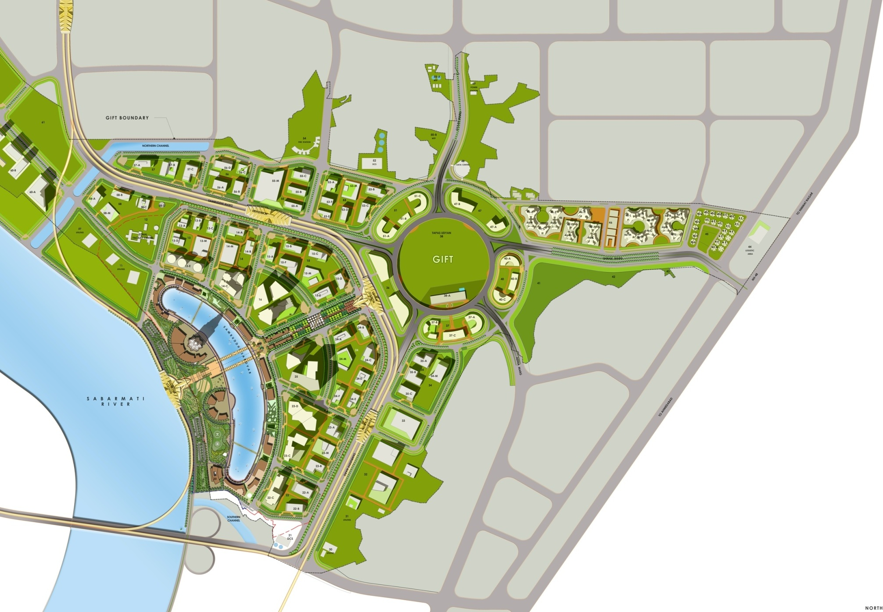
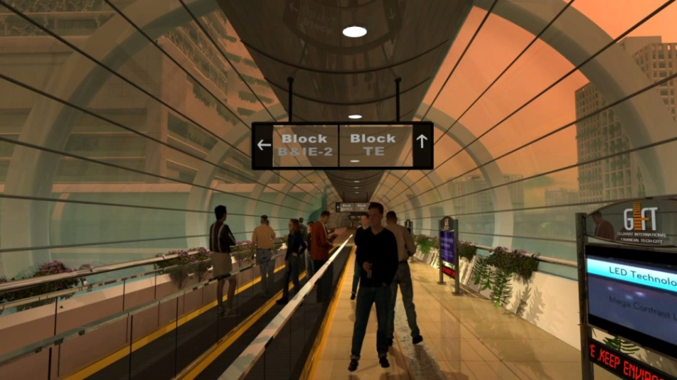
    GIFT- A Transit Oriented Development
    Major Internal Transport Corridor
Major Roads
Arterial Road
Sub-Arterial Roads
MRTS corridor
Walkability
through travellators
Metro station
500 mtrs
Transport Hub
Metro station
Metro station
Walkability
through travellators
Elevated Walkways

Slide 16
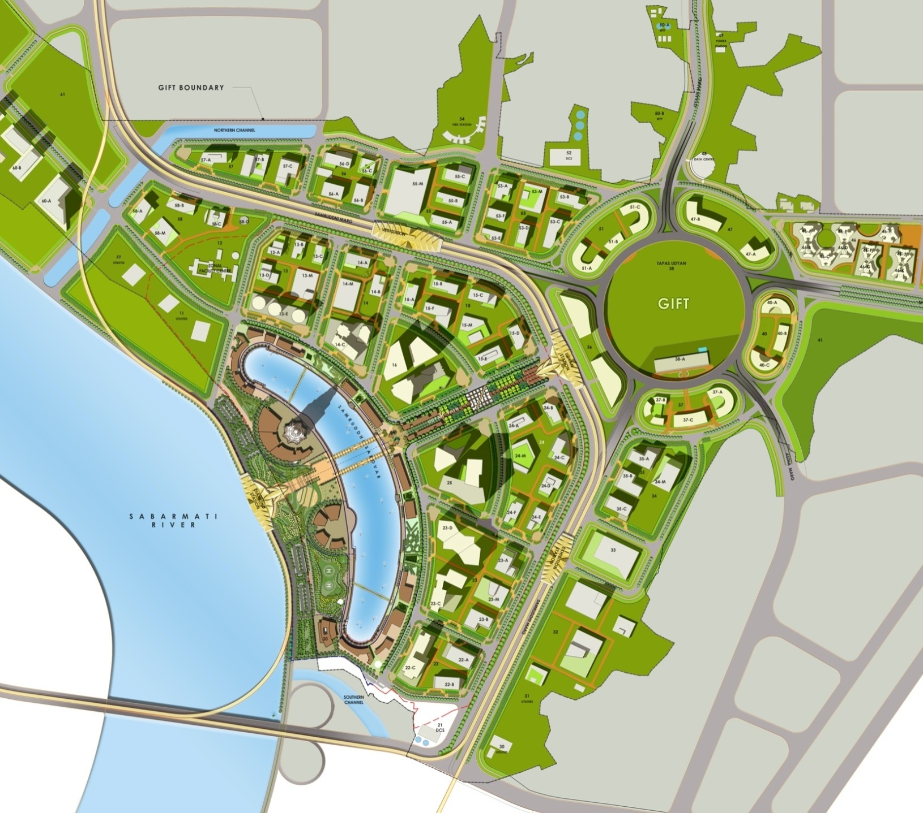
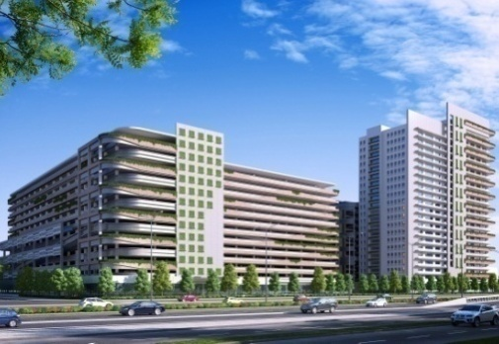
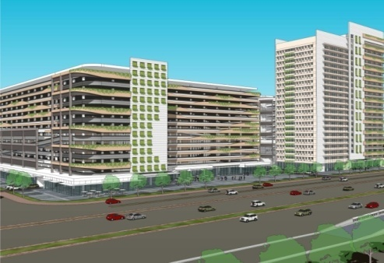
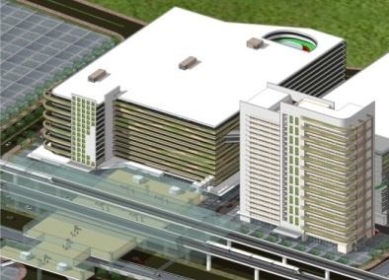
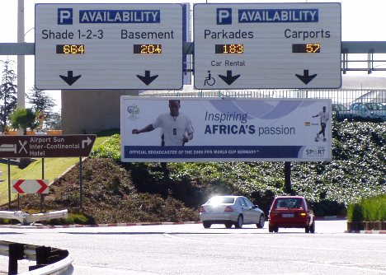
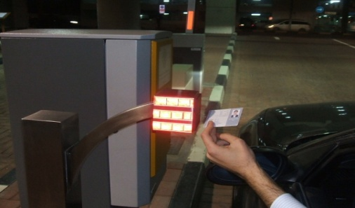
    Multi Level Parking (MLP)
MLP-2
MLP-3
MLP-1
MLP-12
MLP-4
MLP-11
MLP-10
Processing Area -SEZ
Non-Processing Area -SEZ
MLP-5
MLP-9
GIFT’s
MLP-8
MLP-6
MLP-7
GIFT
MLP-2
E-1
  Total Parking Requirement of GIFT City- 1.2 lakhs ECS
  No. of Car Parking in MLP – 60,000 car parks

Slide 17
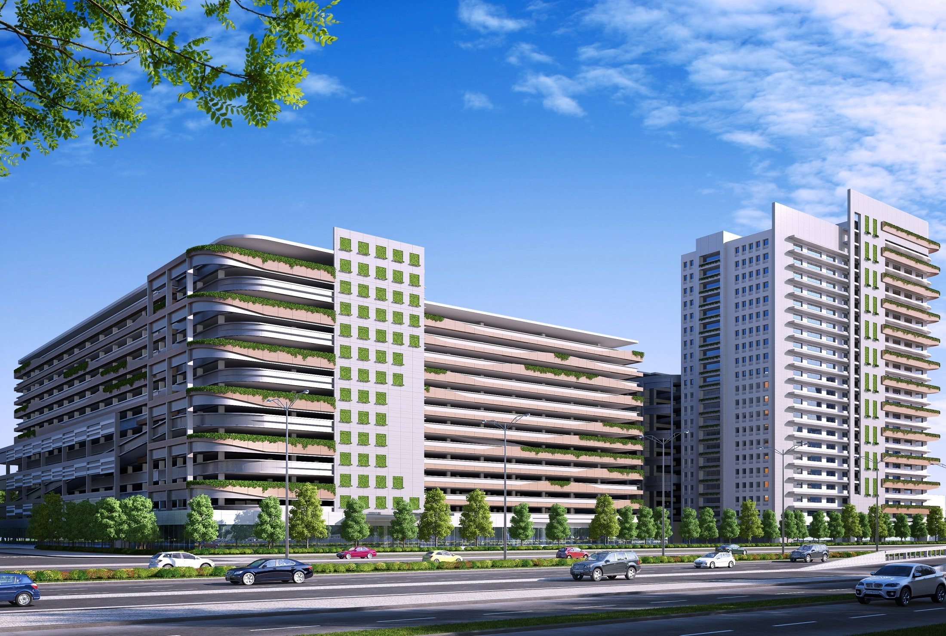
MLP-2

Slide 18
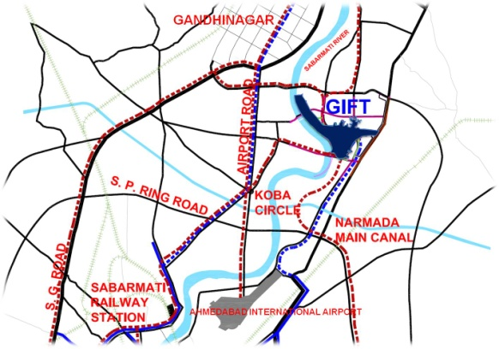
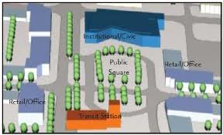
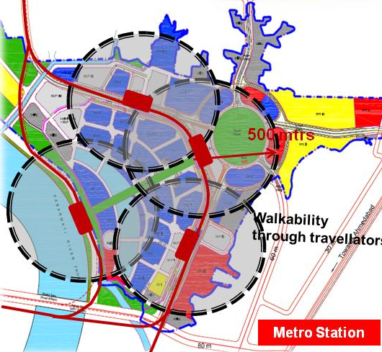
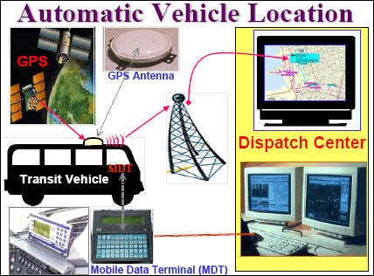
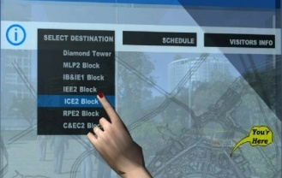
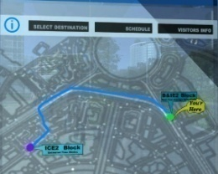
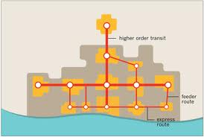
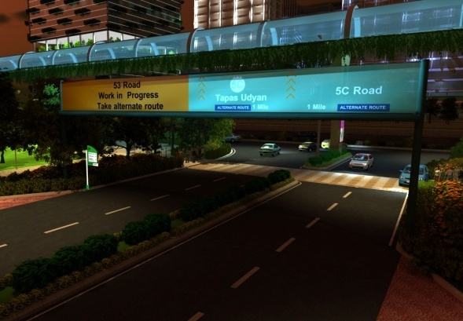
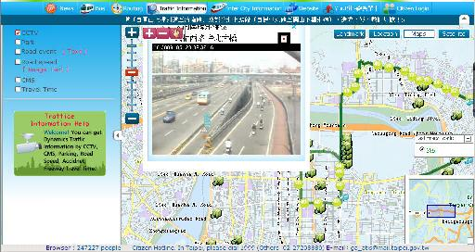
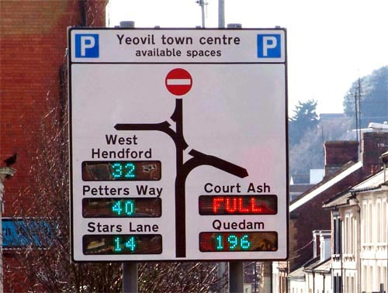
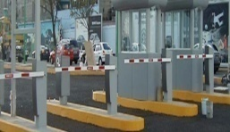
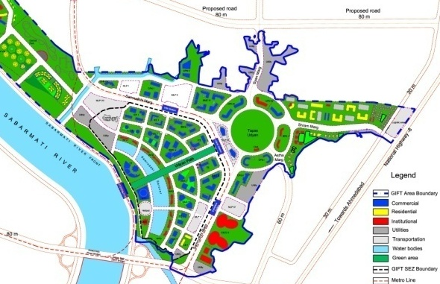
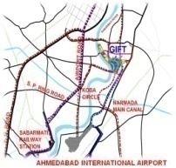
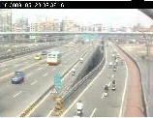
SMART Transportation
  Interactive road maps
  Automatic vehicle location and tracking
  Transit Node Management
  Road condition system
  Real Time Travel Response
  Parking Management
GIFT
GIFT- Road 8C
MLP-I
MLP-I
MLP-II
MLP-II
MLP-IV
MLP-IV
MLP-V
MLP-III
MLP-V
MLP-III
Ridership analysis
Accident reporting
  Vehicle emission monitoring
  Safety management
  Asset Management

Slide 19




    Roads & Street Lights

Slide 20








    Water Infrastructure
Raw Water from Narmada Canal
  SMART Water Infrastructure
Water with sludge
Reservoir
  Utility Monitoring
STP
Waste Water
WTP
Filtered Water
RO Plant
Makeup for Water Bodies
Waste Water
Waste Water
Softening Plant
Horticulture
  Metering
Domestic Uses
Cooling Tower
Flushing Tower
Waste Water
  Leak Detection
  Quality Water- can be drunk from any tap
  Storage of surface run-off & rain water
  Approach towards making the project water neutral
  Controllers
  Drink from Any Tap

Slide 21



    Water Treatment Plant

Slide 22




    District Cooling System
  Total Cooling Load - 2,40,000 TR
  DCS Control Centre- Smart Infrastructure
  Efficiency through economies of scale
  Reduces energy costs
  Reduces maintenance costs
  Improves air quality and temperature control
  Reduces noise and vibration
  Conventional AC System not required
  Monitoring District Cooling Plant System
  Simulation of cooling/energy requirements
  Analyze interface with distribution/usage for both the supply and return elements
  Evaluation of extensive economic scenarios
  Safety Management, Emergency response
DCS-4
DCS-1
DCS-3
DCS-2
Notes:
22

Slide 23



    District Cooling System

Slide 24




    Solid Waste Management
  Maximise resource recovery / minimal emissions
  Minimise impact on environment, human intervention, space requirement, impact on health hazard
  No waste visibility
  Power neutral
  Automatic Collection, Transportation and Segregation System
  Monitoring E-Waste; Bio-medical, Hazardous Waste handling system
  Monitoring Central Waste Handling Facility
  Monitoring Residual Waste handling, rejects
  Safety Management, Emergency response
1
1
2
3
  The waste is thrown into a disposal chute
  Computer controlled access
  Waste sucked through pipes at a speed of 90 km/hr
  Treatment through plasma gasification
Notes:
24

Slide 25








Automated Solid Waste Management
Segregation & Treatment
Separate Collection Pits
Collection
Collection from Building
Transportation
Utility Tunnel
Collection from Public Places

Slide 26


    Automated Waste Collection System

Slide 27



    Power Infrastructure
Underground cabling for power distribution within GIFT
Substation and Distribution Automation
Indoor Substation
      Gas Insulated Switchgears(GIS) substation for sub-transmission and distribution within GIFT
      Compact substation (CSS) in building
      Total Power Requirement- 750 MVA (from dual source)
      Emergency Power generation (Gas Based) - 150 MW
      Green Power
  Power Control Centre
  Power supply monitoring
  Power loss minimization
  Grievance redressal system
  Power consumption and efficiency monitoring
  Emergency Power supply monitoring
  Reliability – 99.999% which means outage of only 5.3 minutes/annum
Notes:
27

Slide 28



    66/33 KV Power Receiving Station

Slide 29




Utility Tunnel Alignment
Trunk line for Non-SEZ
Trunk Lines in SEZ
Connectors/ Feeders

Slide 30





Utility Tunnel Details
Power Cables
Power Cables
ICT Cables
Control Cables
Fire
WTP Treated
DCS Blowdown
Raw water
STP Treated
AWCS
DCS Supply
DCS Return
Raw water
Access to Tunnel
Lighting & Ventilation

Slide 31



    Utility Tunnel

Slide 32

    GIFT Fire Station

Slide 33

    GIFT ICT
GIFT Vision
Create a world class financial city by offering an unrivalled business environment to global and local financial services enterprises.
Create leading-edge infrastructure, services and platforms and offer financial services enterprises a significant competitive advantage to operate regionally and globally
GIFT ICT Vision
“Best in Class”
Customer Experience
Gateway to Financial Markets
Cost-effective ICT
Secure & Resilient ICT Environment
Pre-enabled on demand Infrastructure
Notes:
33

Slide 34
    GIFT ICT Vision
GIFT Occupants would have access to following ICT Services
INFRASTRUCTURE
PLATFORMS
SERVICES
High Speed Fibre
Network
Diverse Local and International Connectivity
Pervasive Wireless and Mobile Network
Data Centres
Financial Extranets
CUG to Exchanges
Voice
Industry Specific Platforms
City e-Portal
Sensor Networks
IPTV Internet Gateway
Data
Voice
Wi-Fi
Tier-4 Data Centres
Business Continuity
Security
High Speed Internet Access
Monitoring
Notes:
34
1

Slide 35
    Vision for Operation & Maintenance
“Identify the defects before consumer noticing it.
Rectify the defect before receiving the complain.”

Slide 36

    Smart City GIFT Development
Smart Transport
Smart Urban Infrastructure
  Traffic Mgmt
  Parking
  Area Traffic Control
  Road Condition System
  Real Time Travel Response
Smart Streets
  Digital Signage
  Streetscape
  Water Systems
  Power
  ICT System
  District Cooling
  Domestic Gas
  Waste Management
  Fire Fighting
  Utility Tunnel
Smart Landscape
City Command and Control Centre (C4)
  Irrigation System
Smart Buildings
  Offices
  Home
  Hotel
  School
  Hospital
Smart Desks
Smart City Security and Surveillance
  City Information
  Facilitation Centers
Notes:
36
36
1

Slide 37



    Central Command & Control
Control Center
(Transport)
Control Center Building Package-A
Control Center (Water)
Control Center Building Package-B
City Control and Command Center (C4)
Control Center
(SWM)
Control Center Building Package-C
Control Center
(DCS)
Control Center Building Package-n^{th}
Security & Vigilance
Control Center
C4 will take critical live feeds from all Control Centers
C4 will take remedial actions in case of emergency

Slide 38

    Data Centre
Tier IV Data Centre
900 Racks
0.1 Mn Sqft
Investment of around Rs. 150 Cr
Employment Generation- 100
To be operational by 1st June-2015

Slide 39

    GIFT Intelligent Buildings
  24% saving on building management system
  4.5% saving on total build cost
  36% saving on operational expenditure

Slide 40


    Office Buildings – GIFT ONE and GIFT TWO
Total BUA –approx. 0.8 mn sq ft (each)
Structure: Basement + 28 Floors
Tallest Buildings in Gujarat
Grade A Commercial Office space with high end technical specifications and features like district cooling, vacuum based waste management system, Intelligent Building Management System, Energy Efficient Green Building
Vertical transportation: Through 12 high speed elevators with a speed of 4m/sec

Slide 41
International Award/Recognition
  GIFT City has been conferred as “Smart City of Future” by Cisco Technology Award 2014
  GIFT is recipient of IDC ICONIC Award 2014 in Government Sector category
  GIFT won e-LETS Award 2014 for “Innovative Solutions for Smart City”
  GIFT City was awarded “Best Industrial Development & Expansion” by the “World Finance Infrastructure Investment Awards - 2012” at London. ( beating Songdo – South Korea & Moscow International Finance Center – Russia)
  GIFT City is amongst the 10 top infrastructure projects of India according to Economic Times and Rediff
  GIFT City selected as one of the world’s ‘Strategic Top 100 Infrastructure Projects’ in 2014 by CG/LA Infrastructure, 25 year old US based firm.
  GIFT City got a recognition in “Innovation in Utility Transmission & Distribution Infrastructure 2013” presented by Bentley Systems at London
  Leadership in Integrated Green City Design Planning at Green Cities Forum in 2014
  GIFT City received ICI Utratech Award for Outstanding Concrete Structure of Ahmedabad in 2013

Slide 42
  Thank you……

